Slide 1

The connectivity and distribution
of free-living marine nematodes
Ann Vanreusel
Meioscool, Brest, 27 juni 2016

Slide 2
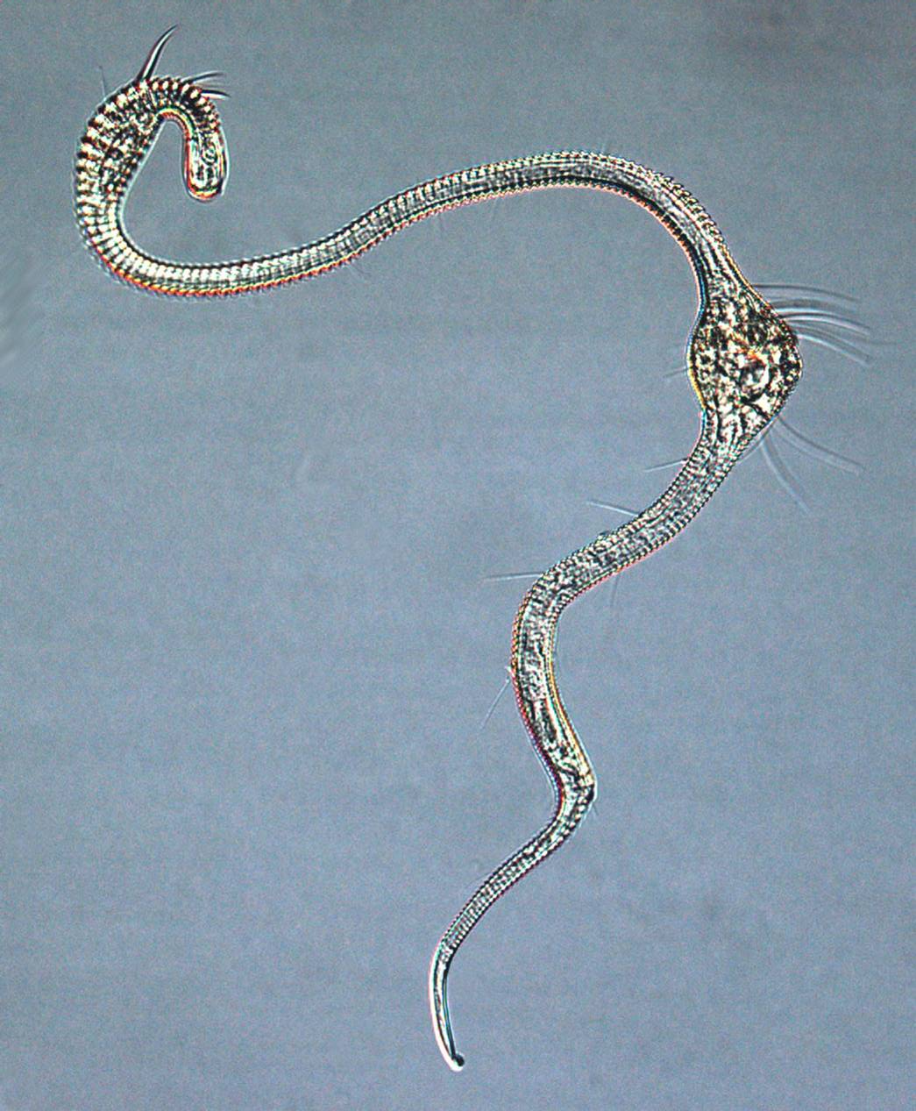
The connectivity and distribution of free-living marine nematodes
Introduction
  Their biology
  Their success
Connectivity and distribution
  Cosmopolitan species
  Cryptic species
  Population genetics
3. Environmental management context
  Importance of cryptic diversity
  Connectivity between protected areas
  Recolonization of disturbed areas

Slide 3
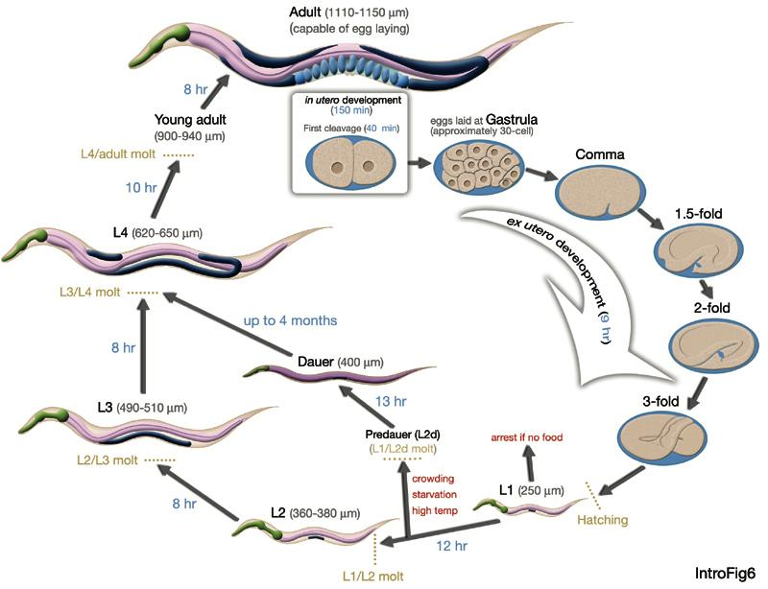
Introduction : Their biology – Life strategy
Life Cycle of the nematode C. elegans
www.wormatlas.org

Slide 4
Introduction : Their biology – Life strategy
Hatched juvenile
150 µm
Adult
40 µm
800 µm
Singh et al, 2009

Slide 5
The connectivity and distribution of free-living marine nematodes
Introduction
  Their biology ➔Life strategy
    Dioecious (copulation)
    Oviparous (eggs in environment)
    Occasionnaly Ovoviviparous
    ≠ juvenile stages (molting)
    (Dauer larva for some Rhabditids) )

Slide 6
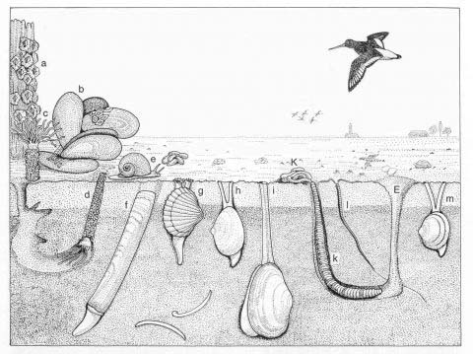
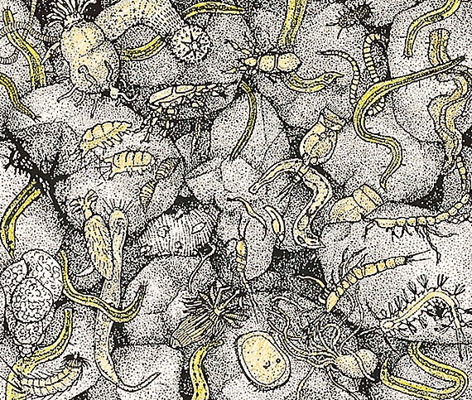
Introduction
  Their success
“Meios “ intermediate to micro- and macrofauna
Retained on 38 (or 32) µm sieve
Protists (forams) and metazoans
Almost exclusively associated with seafloor (s.l.)
- mainly as endofauna in soft sediments
- also as epifauna on ‘hard’ substrates
macrofauna
meiofauna
www.senckenberg.de

Slide 7
Introduction
  Their success
  Metazoan meiofauna : Nematodes dominant

Slide 8
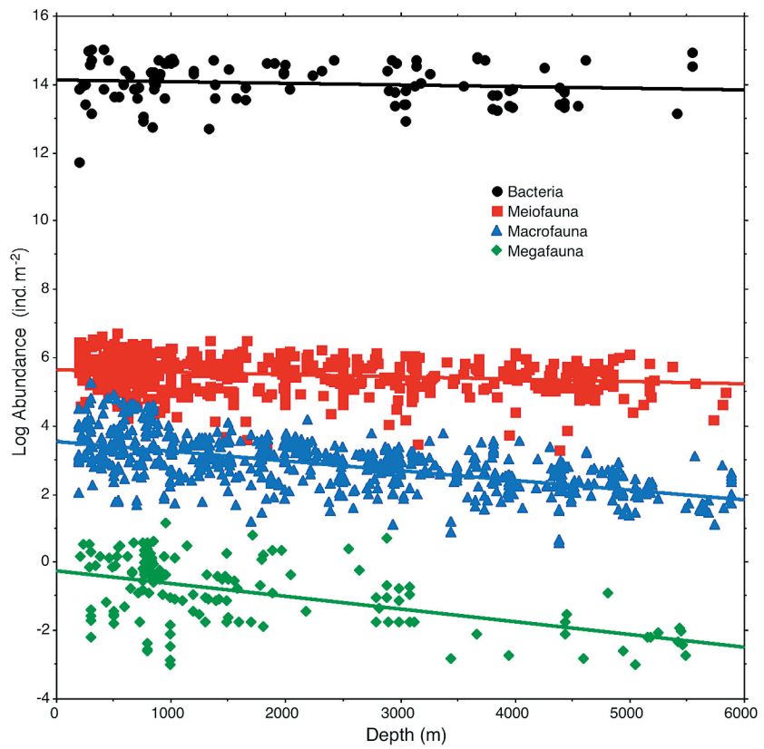
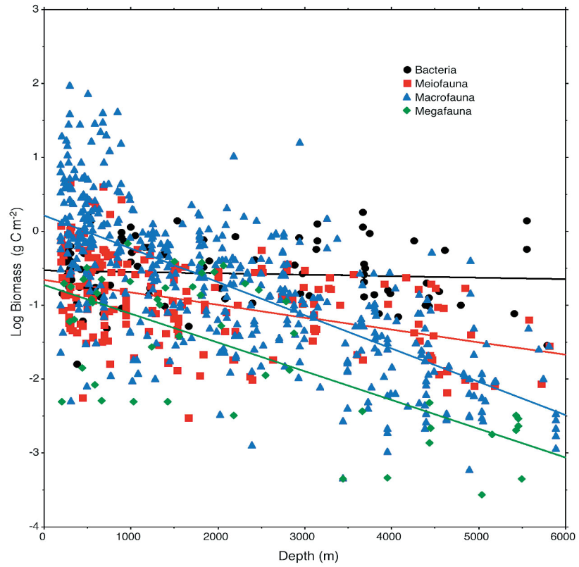
Introduction
  Their success
  Meiofauna increases in importance with increasing water depth
Log Abundance (ind. m⁻²)
Log Biomass (g C m⁻²)
Water depth
Rex et al. (2006)

Slide 9
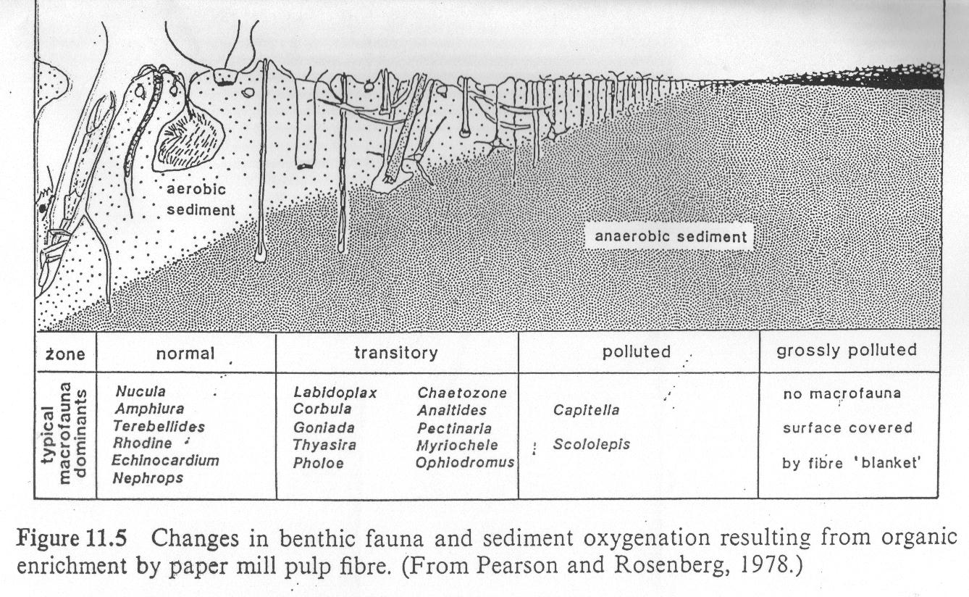
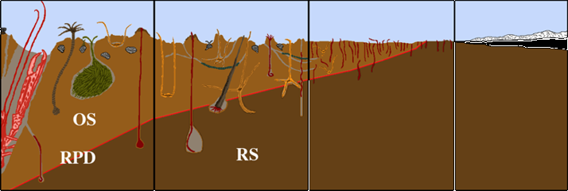
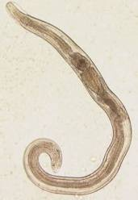
Introduction
  Their success
  Often remaining taxon in anoxic conditions

Slide 10
Normoxia Anoxia Recovery
23 days 30 days
Normoxia Anoxia Recovery
23 days 30 days
Densities
Species richness

Slide 11
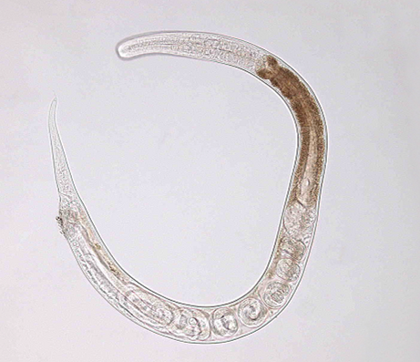
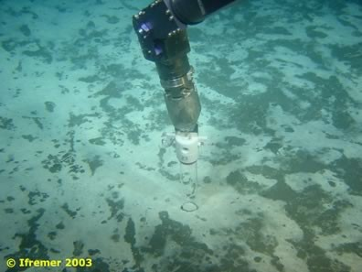
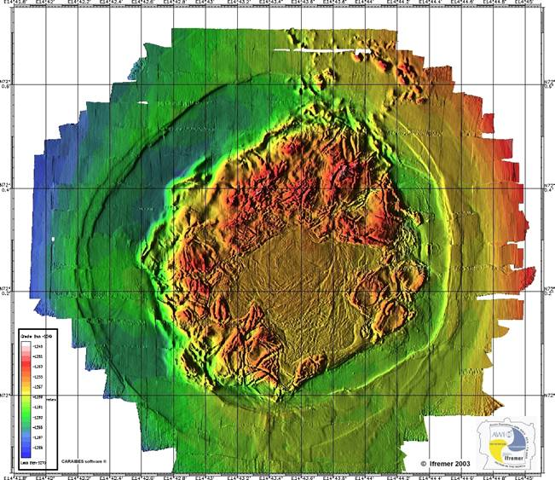
Håkon Mosby Mud volcano at Barents sea slope (1280m)
Van Gaever et al, 2006
H₂S, O₂ (mM)
0
1
2
3
4
0,1 0,3 0,5 0,7 0,9 1,1
Halomonhystera species
more than 10 000 ind/10 cm² in bacterial mats
Depth (cm)
100 µm
0 1 10 100
nematode densities x 10 ⁶ per m²

Slide 12
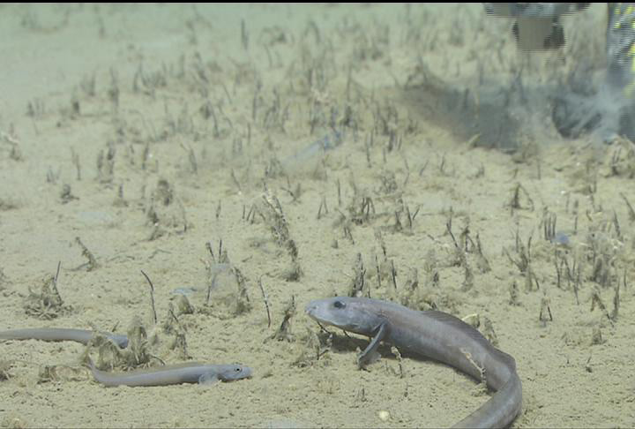
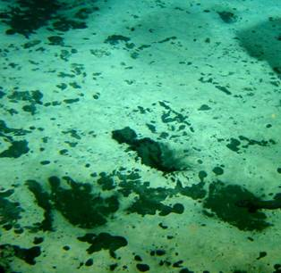
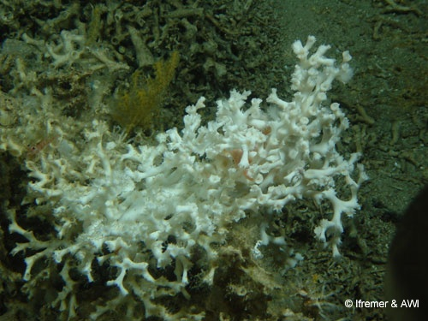
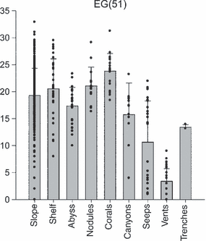
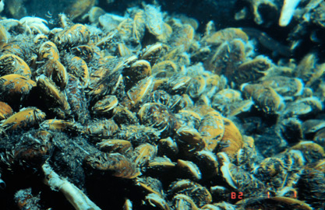
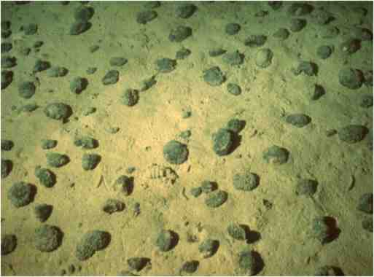
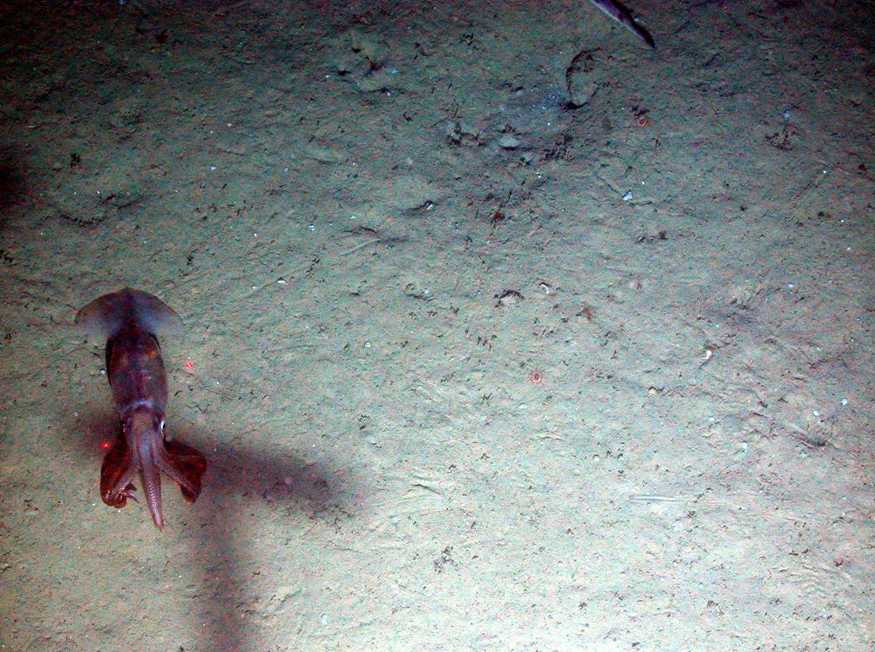
Cold seeps
Ifremer
Coral rubble
expected nr of genera
(rarefraction)
Expected number of genera
for 51 individuals
Ifremer
NOC
Ifremer
Ifremer & AWI
mbari
Soft sediments :
Shelf
Slope
Abyss
Trench
Manganese
nodules
Seamounts
Cold water corals
Vanreusel et al 2010
Hydrothermal
vents
Canyons
NOC
Ifremer
Ifremer

Slide 13
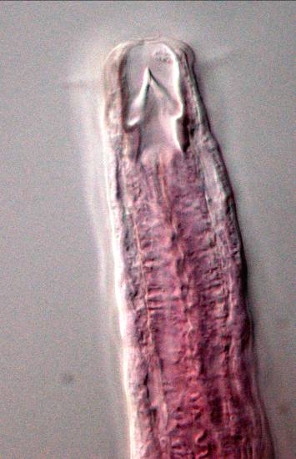
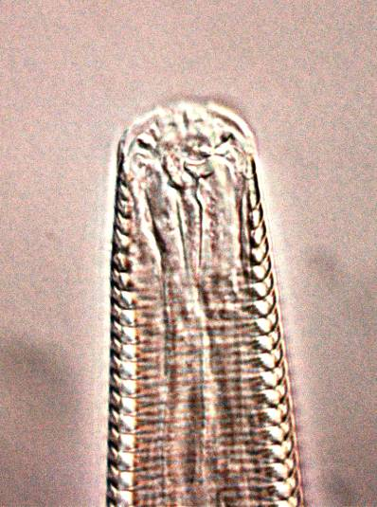
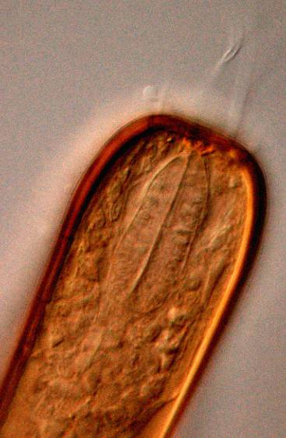
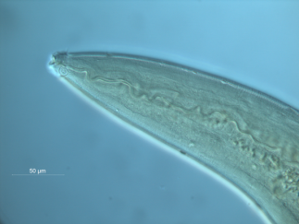
Introduction
  Their success
  (Most) abundant and species rich metazoan phylum of (deep-sea) benthos
  Appears in (almost) all marine sea-floor associated environments
  Wide trophic range and flexibility (Moens and Vincx, 1997)

Slide 14
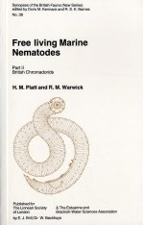
The connectivity and distribution of free-living marine nematodes
Introduction
Connectivity and distribution
  Cosmopolitan species

Slide 15
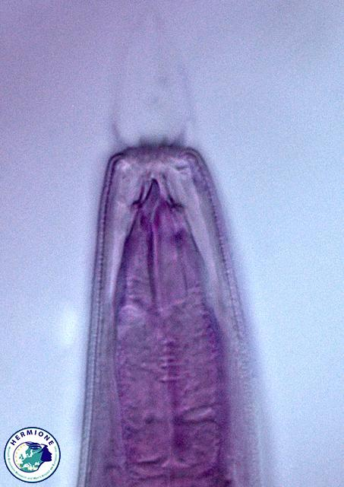
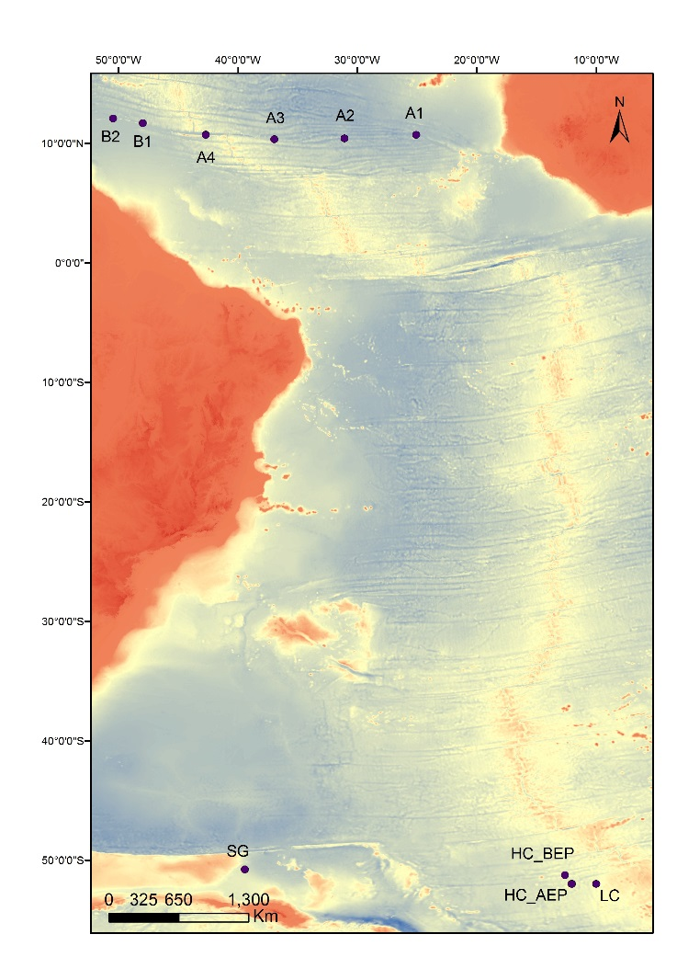
2. Connectivity and distribution
  Cosmopolitan species
Lidia Lins et al in prep
Acantholaimus
Mid Atlantic ridge

Slide 16
The connectivity and distribution of free-living marine nematodes
2. Connectivity and distribution
  Cosmopolitan species
Species composition and diversity
of Acantholaimus
60° South 10° North

Slide 17
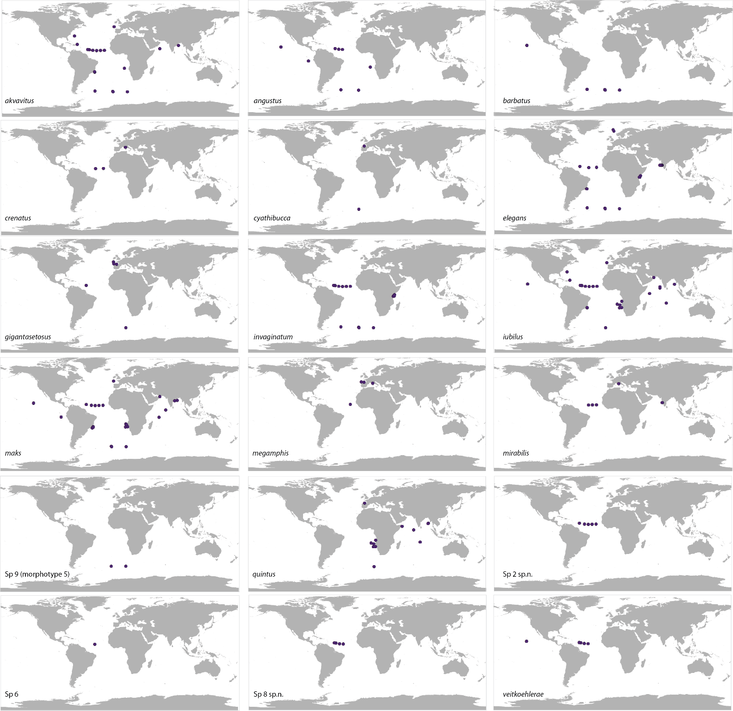
Known global distribution of Acantholaimus species

Slide 18
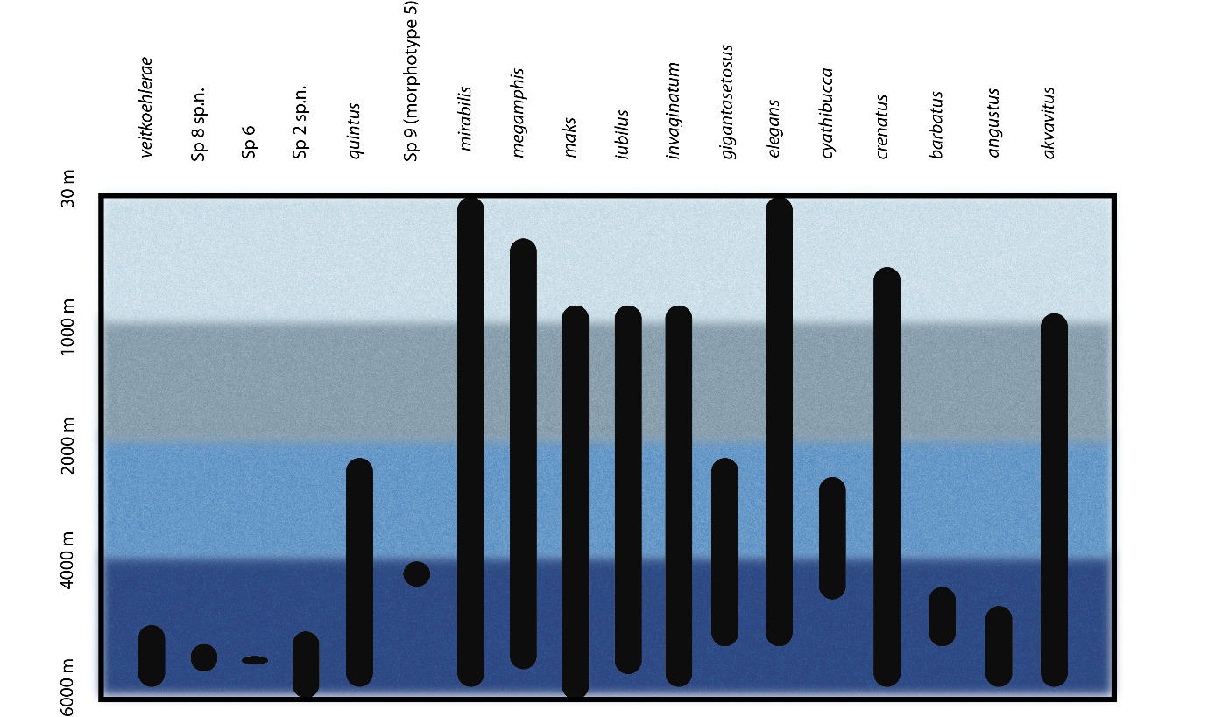
2. Connectivity and distribution
  Cosmopolitan species
Bathymeteric distribution of
Acantholaimus species

Slide 19
2. Connectivity and distribution
  Cosmopolitan species (molecular defined)
  ➔ comparison of 6 globally distributed locations
Derycke, Guillini et al, in prep

Slide 20
The connectivity and distribution of free-living marine nematodes
Introduction
Connectivity and distribution
  Cosmopolitan species
  Cryptic species

Slide 21
Sympatric cryptic species complex of Halomonhystera disjuncta
Derycke et al. 2007

Slide 22
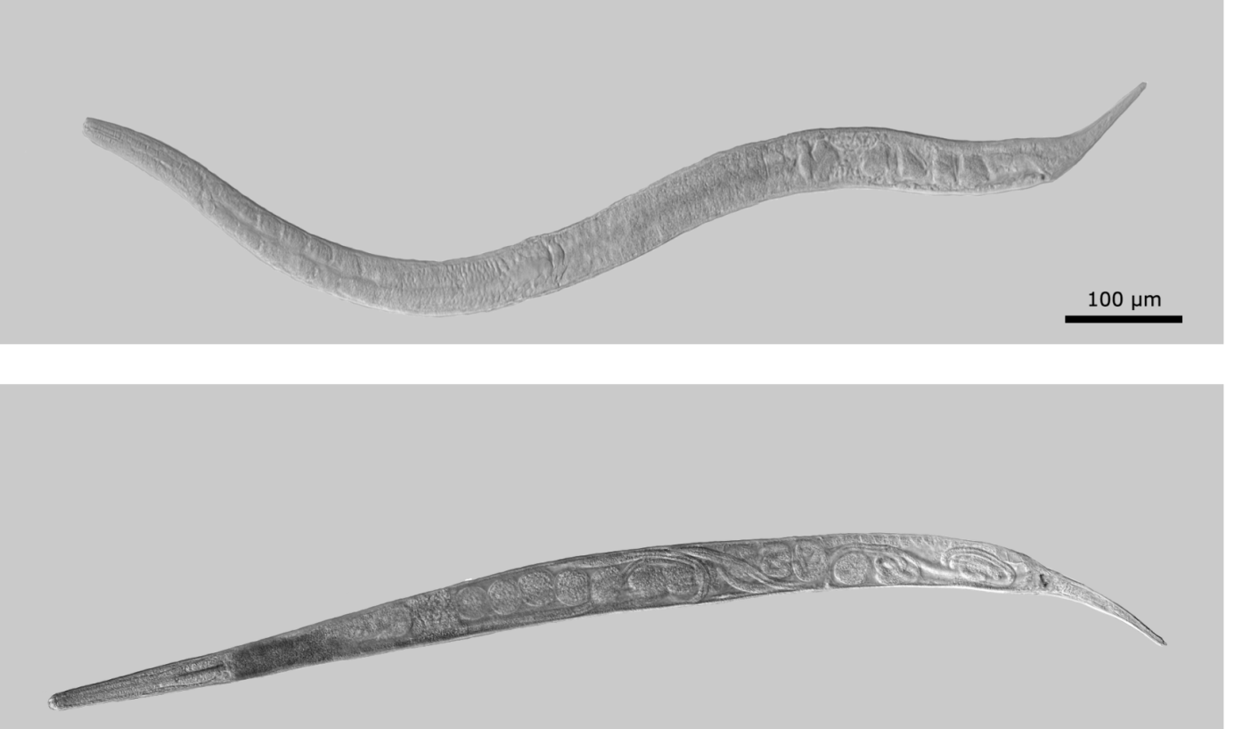
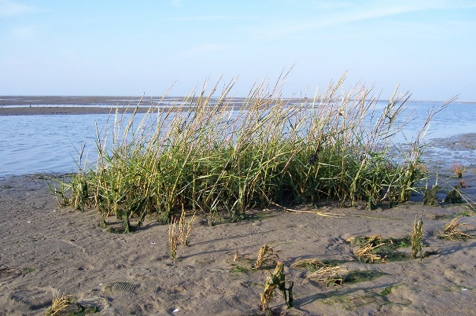
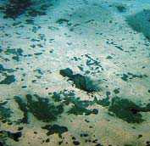
HMMV, Barents Sea, at 72°N 14°E, 1280 m
Sulphide rich sediments of bacterial mats colonized by high densities of
H. disjuncta
Ovoviviparous reproduction strategy

Slide 23
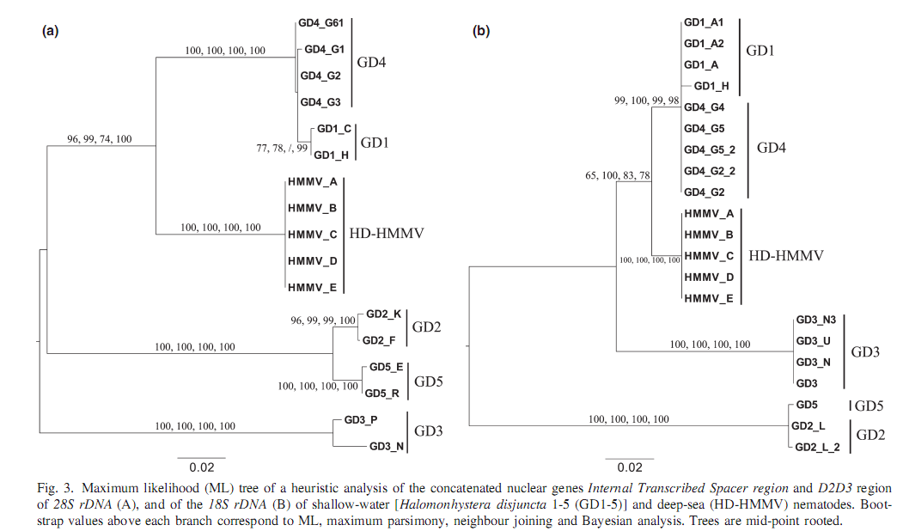
Phylogenetic analysis of H. disjuncta complex
Van Campenhout et al 2014
ITS
18SrDNA
HD HMMV is one of several cryptic species from a species complex known to be associated
with degrading macroalgae on temperate mud flats (GD1-GD5) De Rycke et al 2007
HD-HMMV is a seperate group but more closely related to GD1/4 than other sympatric species
Notes:
Phylogenetische boom gebaseerd op de nucleaire merker ITS (internal transcribed spacer). Dit stukje sequentie is 900 base paren lang.
Het belangrijkste zijn de nummers op een knooppunt (node).
Het nummertje 97 (omcirkeld) geeft aan dat dit een juist classificatie is. Hoe dichter bij 100 hoe beter. Deze boom toont dus aan dat HD-HMMV clustert in de boom van GD1-5 en er niet buiten valt. Door de hoge node-scores van deze boom kan je ook zeggen dat HD-HMMV duidelijk meer verwant is aan GD1 en 4 dan met GD2,3,5.
DM_900bp en Ddvit2_900bp is Diplolaimelloides een soort die gekozen werd omdat de sequentie afwkijkt van alle GD’s en HD-HMMV inclusief en ervoor zorgt dat onze boom een startpunt heeft (de outroup worden deze sequenties

Slide 24
HMMV, Barents Sea, at 72°N 14°E, 1280 m
Sulphide rich sediments of bacterial mats colonized by high densities of
H. disjuncta
H. hermesi (Tchesunov et al, 2015)
Ovoviviparous reproduction strategy
New species described as H. hermesi and closely related to coastal Halomonhystera disjuncta species

Slide 25
The connectivity and distribution of free-living marine nematodes
Introduction
Connectivity and distribution
  Cosmopolitan species
  Cryptic species
  Population genetics

Slide 26
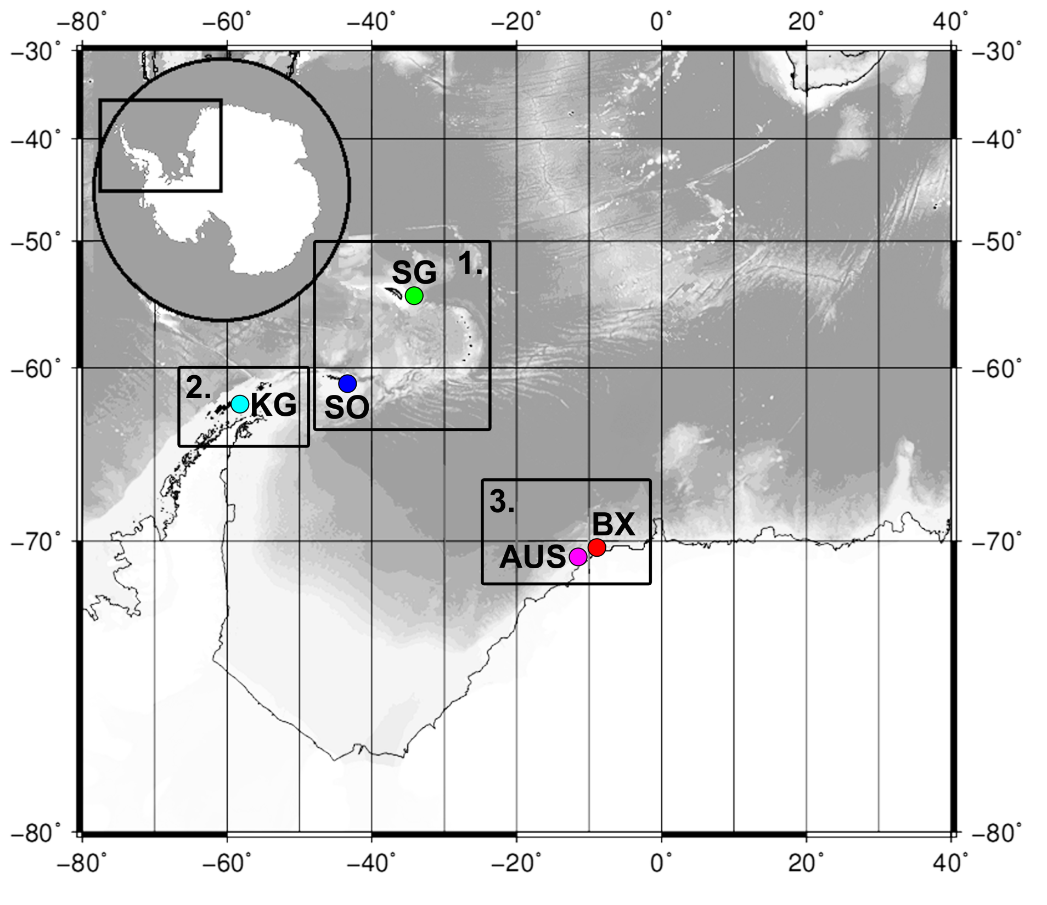
5 locations at 300-500m
Box 1. Scotia Arc
SG = South Georgia
SO = South Orkneys
Box 2. Antarctic Peninsula
KG = King George Island
Box 3. Eastern Weddell Sea
AUS = off Auståsen ice rise
BX = Bendex (no geographic ref)
1600 km
600 km
~2100 km
2100 km
~2300 km
1900 km
~15 km
Freija Hauquier et al. In prep
Two research hypotheses:
1. strong population genetic structure between distant locations (cryptic species?)
2. surface-dwelling nematodes are more easily resuspended and transported by bottom currents than deeper-dwelling nematodes, hence will have less strong population genetic structure

Slide 27
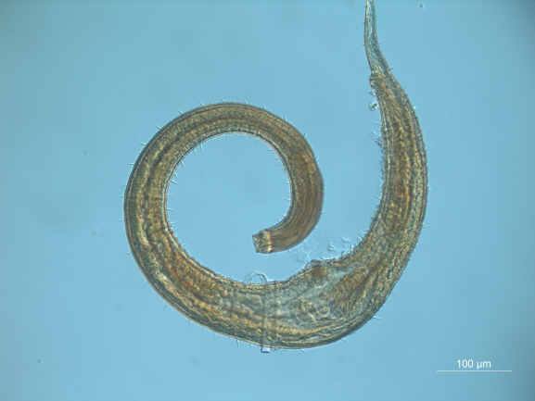
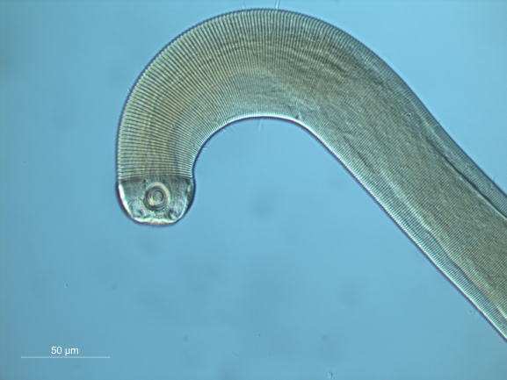
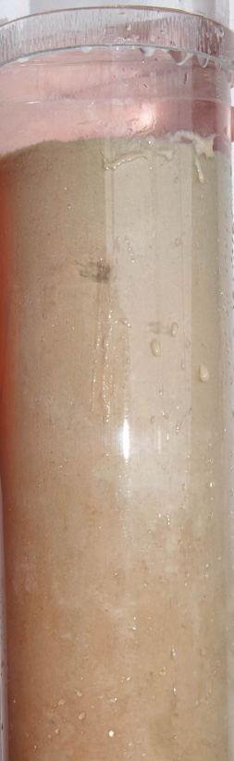


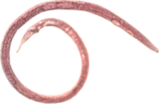

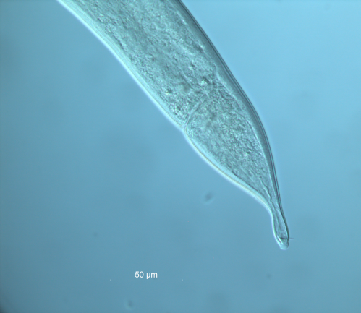
Diversity and population genetics of two abundant genera in Southern Ocean
0 – 3 cm
57mm
‘surface’ communities
food
oxygen
more prone to resuspension
30 mm
Desmodora
3 – 5 cm
‘subsurface’ communities
less food
oxygen rapidly decreasing
less likely to become resuspended
20 mm
2 sediment slices
0 – 3cm
3 – 5cm
Stored on DESS
Sabatieria
2 genera selected based on general occurrence at all 5 locations
Desmodora = surface-dwelling epistratum feeder
Sabatieria = deeper-dwelling deposit feeder
(tolerant to low O₂ levels)

Slide 28
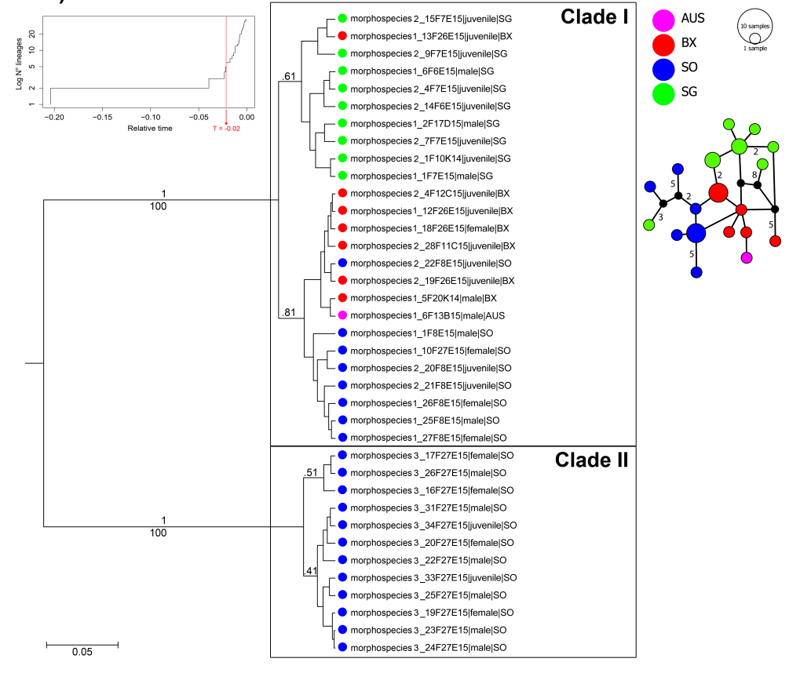

2 species clades based on COI
species I: widely spread, yet substantial genetic differentation between populations
large intraspecific phenotypic variation (2 morphospecies)
species II: only at location SO (but may be sampling bias)
Bayesian trees of COI haplotypes for Desmodora.
Colours = locations
Haplotype network
(numbers along branches
= number of base differences
No number = only 1 difference)
Clade I
Surface dwelling Desmodora

Slide 29
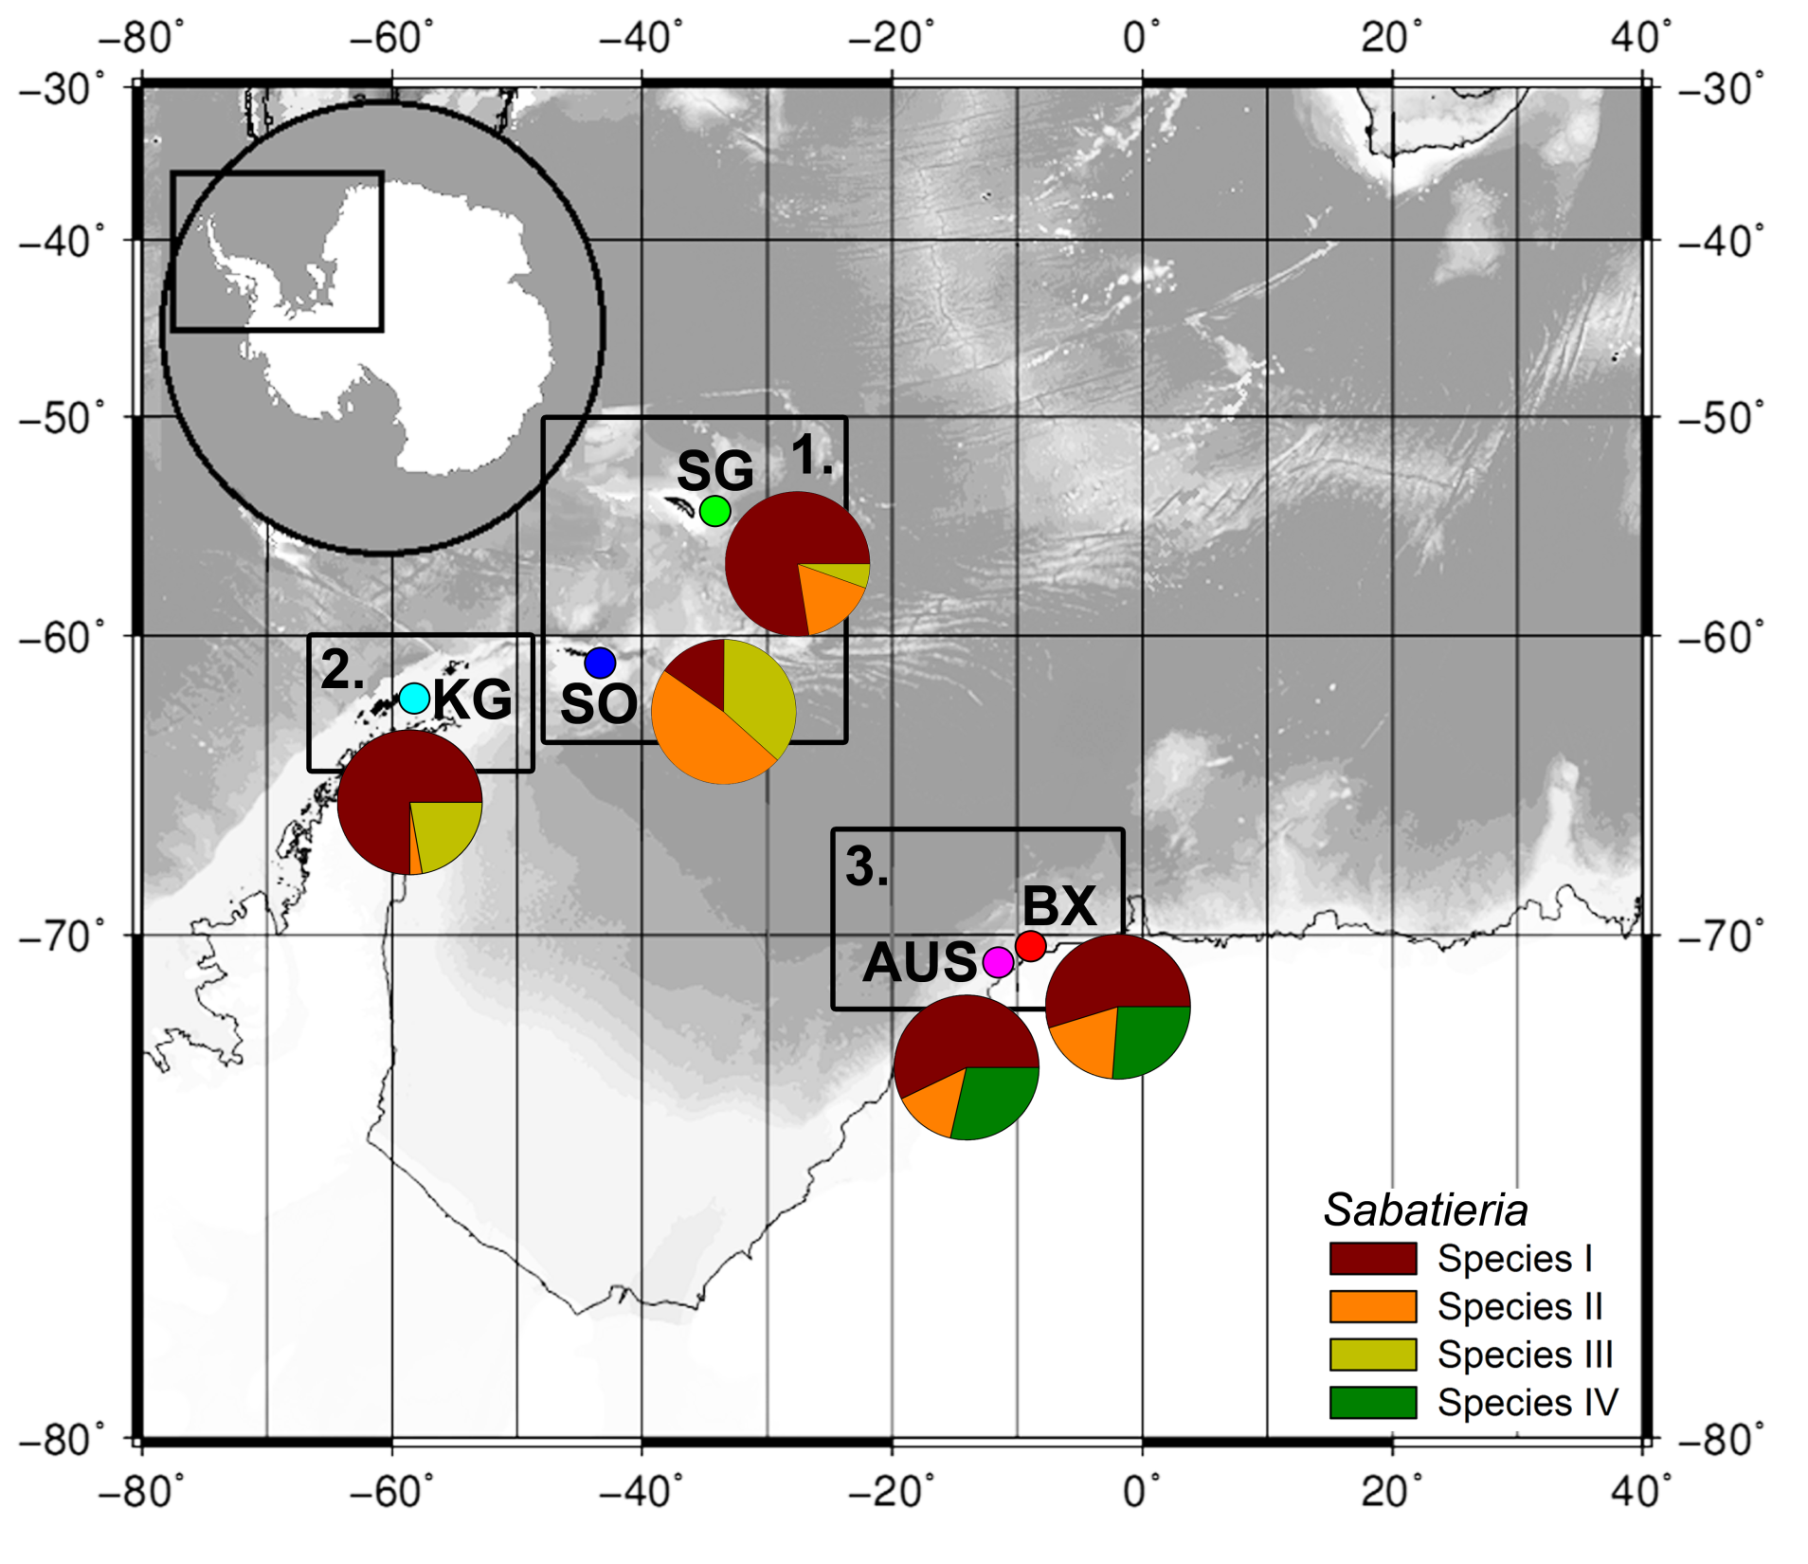
Sabatieria ➔ 4 species
Subsurface species
wide range
narrow range

Slide 30
Species I
haplotype network for ITS
Strong population genetic structure in
Sabatieria species with wide distribution range (higher Φ_{st} values in AMOVA)

Slide 31
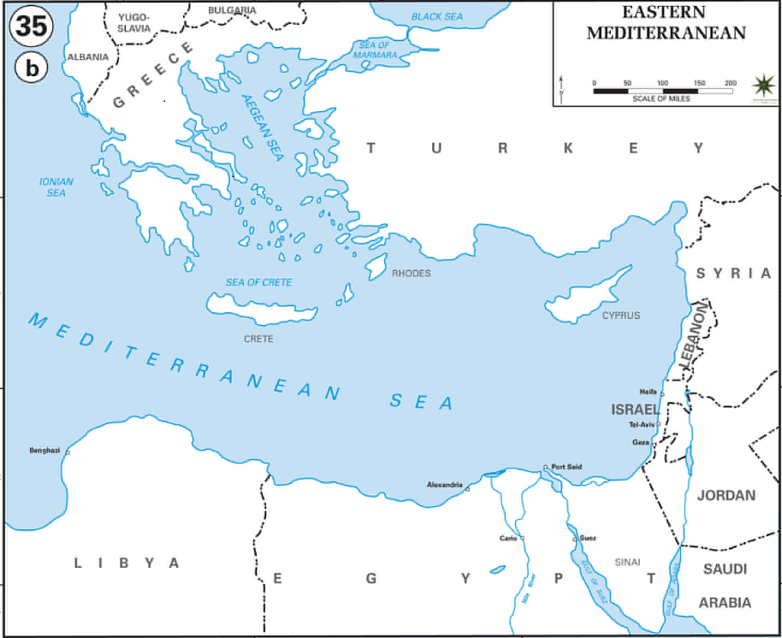
Sabatieria species associated with reduced seep sediments in East Med.
Annelies De Groote et al.
MEDECO cruise (2007):
Central Pockmark area (1700 m)
Brine lake Cheops (3000 m) + Leopard skin pattern (3014 m)
Madonna mud volcano (1650 m, Central Mediterranean area)
Merian cruise (2009):
Central Pockmark area (1700 m)
Amon mud volcano (1150 m)
Amsterdam mud volcano (2050 m)
Amsterdam MV
Brine lake Cheops
Amon MV
Central pockmark area
MEDECO cruise (2007)
Maria S. Merian cruise (2009)

Slide 32
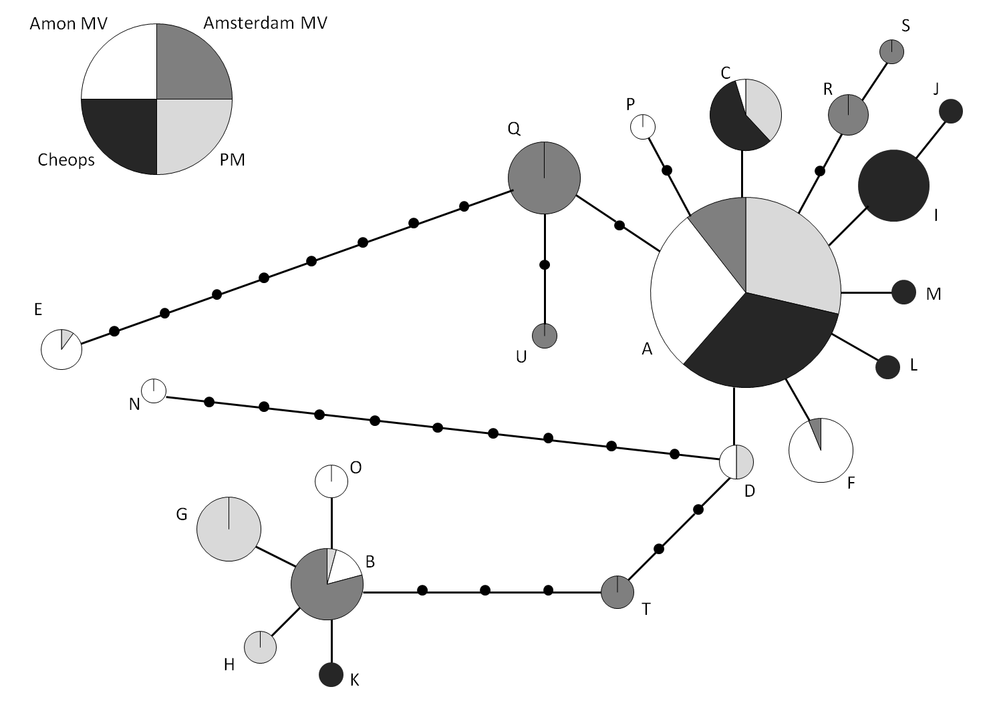
Connectivity among isolated seeps of East Med
Amon
A’ dam
331 ind.
COI
Cheops
PM
21 haplotypes, 6 found in multiple seeps
Haplotype A: widespread in all seeps
Most haplotypes: exclusively found in one seep, in very low adundances
Haplotypes E - N: more mutational differences
AMOVA: Φ_{ST}-value:15 % variability explained by differences between seeps

Slide 33
The connectivity and distribution of free-living marine nematodes
Introduction
Connectivity and distribution
  Cosmopolitan species
  Cryptic species
  Population genetics
3. Environmental context
  Importance of cryptic diversity

Slide 34
Phylogenetic analysis of H. disjuncta complex
Importance of cryptic diversity
Van Campenhout et al 2014
ITS
18SrDNA
HD HMMV is one of several cryptic species from a species complex known to be associated
with degrading macroalgae on temperate mud flats (GD1-GD5) De Rycke et al 2007
HD-HMMV is a seperate group but more closely related to GD1/4 than other sympatric species
Notes:
Phylogenetische boom gebaseerd op de nucleaire merker ITS (internal transcribed spacer). Dit stukje sequentie is 900 base paren lang.
Het belangrijkste zijn de nummers op een knooppunt (node).
Het nummertje 97 (omcirkeld) geeft aan dat dit een juist classificatie is. Hoe dichter bij 100 hoe beter. Deze boom toont dus aan dat HD-HMMV clustert in de boom van GD1-5 en er niet buiten valt. Door de hoge node-scores van deze boom kan je ook zeggen dat HD-HMMV duidelijk meer verwant is aan GD1 en 4 dan met GD2,3,5.
DM_900bp en Ddvit2_900bp is Diplolaimelloides een soort die gekozen werd omdat de sequentie afwkijkt van alle GD’s en HD-HMMV inclusief en ervoor zorgt dat onze boom een startpunt heeft (de outroup worden deze sequenties

Slide 35
Life-history response of coastal GD1-3 species
to bathyal cold seep conditions
Life history response of GD1-3 at a salinity of 34, a temperature of 4°C and in the presence of 1mM sulphides (Na₂S).
End of experiment: F1 adults are sexually active
First dead inoculated nematode
Start (6 females, 4 males)
First adult(s)
First egg(s)
First Juvenile(s)
17-18 days
7-10 days
12-17 days
17-18 days
Minimum generation time
Egg deposition time
Embryonic development
Juvenile development
Minimum adult life span
Van Campenhout, et al 2015

Slide 36
3. Environmental context
  Importance of cryptic diversity
Different tolerance of cryptic species of Halomonhystera disjuncta (GD1,2 and 3) to changes in environment (sulphides, temperature and pH).
Offspring minimum adult life span
p = 0,006
p = 0,0001
GD1 GD2
GD1 GD2
GD3 did not survive in the presence of sulphides.
Van Campenhout, et al 2015

Slide 37
3. Environmental context
  Importance of cryptic diversity

Slide 38
3. Environmental context
  Importance of cryptic diversity
De Meester et al, 2011
Different species interactions between species in changing environmental conditions

Slide 39
The connectivity and distribution of free-living marine nematodes
Introduction
Connectivity and distribution
Environmental context
  Importance of cryptic diversity
  Connectivity between different areas

Slide 40
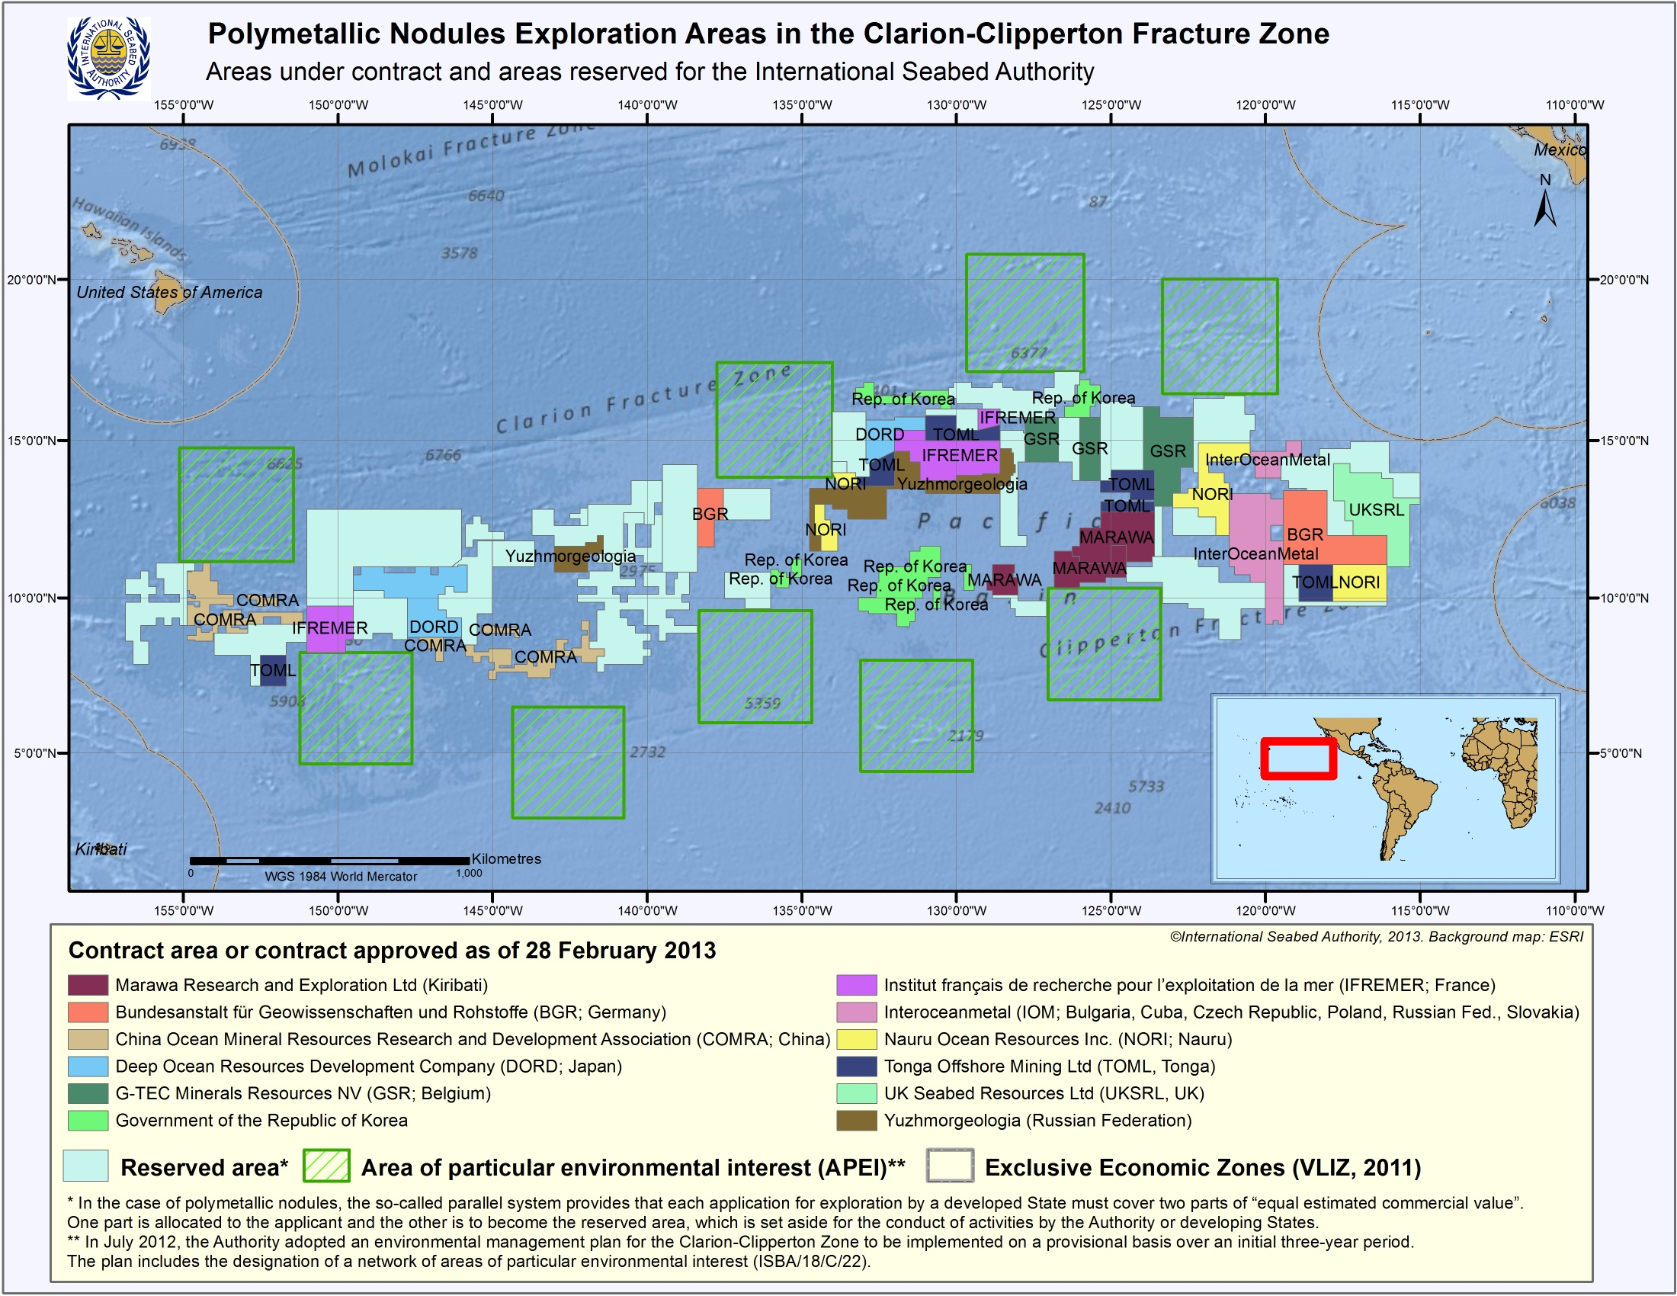
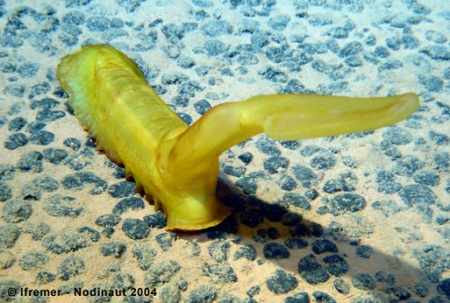
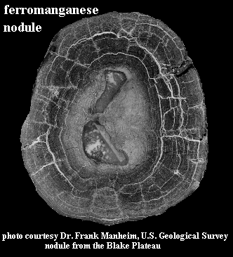
www.isa.org

Slide 41
Are APEIs effective and representative?
Environmental Management Plan for the Clarion Clipperton Zone
9 areas of particular environmental interest (APEI), on a provisional basis, to protect the biodiversity and ecosystem structure and functioning of the zone
APEI = “large areas with self-sustaining populations and a broad range of habitat variability”
www.isa.org

Slide 42
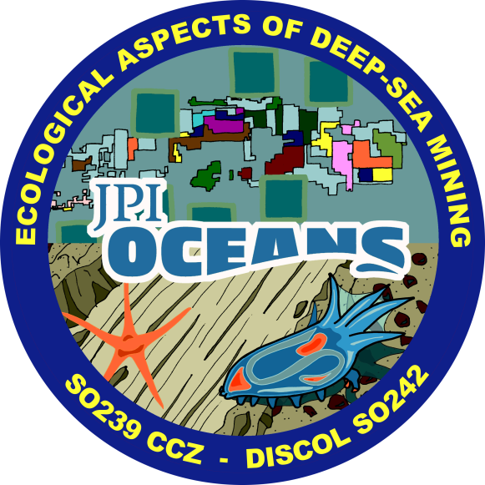
Turnover
East West
≠ ≠
30 % species loss
= =
No species loss

Slide 43
The connectivity and distribution of free-living marine nematodes
Introduction
Connectivity and distribution
Environmental context
  Importance of cryptic diversity
  Connectivity between different areas
  Recolonization of disturbed areas

Slide 44
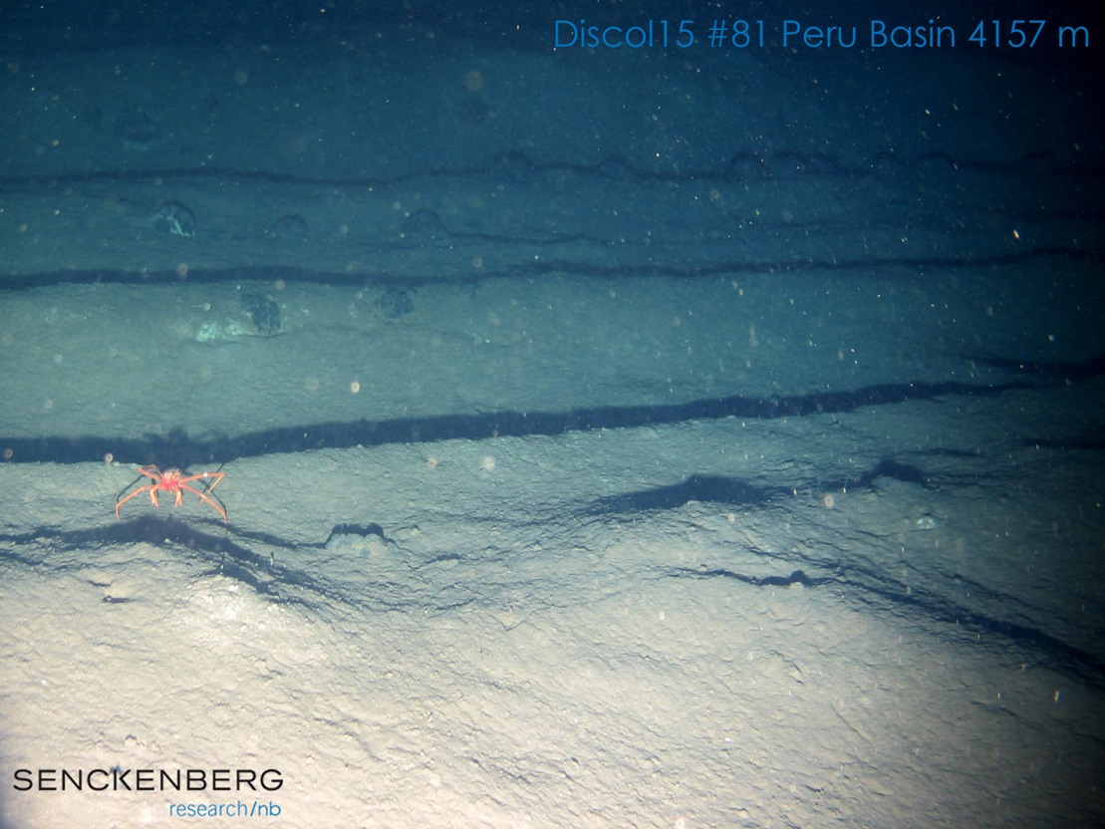
Mevenkamp et al
26 year old disturbance in nodule area
2 Crest
1 White spot
3 Valley
5
3
2
1
4 Outside track

Slide 45
The connectivity and distribution
of free-living marine nematodes
Is the sky the limit?
‘Everything is everywhere ‘ ?
Distribution through water column (?)
Thank You !!!

