Slide 1


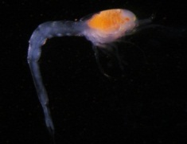
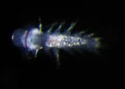

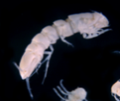



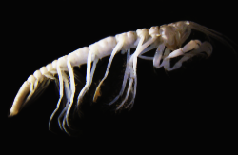

Metabarcoding : a tool to accelerate biodiversity assessments ?
Florence Pradillon & Sophie Arnaud-Haond
Ifremer
Meioscool 2016, IUEM, 27 June - 1st July 2016
Notes:
As we have just heard, DNA taxonomy and molecular barcodes are increasingly used in biodiversity surveys and community analyses as a complementary tool to traditional morphological species identification. The next step in the use of genetic information, which is developping at a quick pace, is metabarcoding. I will try to present these approaches which are expected to allow rapid biodiversity assessments.
I must say that I am a beginner with these methods, which we willl be testing and applying at Ifremer within a very new project that was launched last month, which we called « Pourquoi pas les Abysses », short name ABYSS, and which will focus on deep-sea biodiversity. I will talk a bit about the ABYSS project at the end of my presentation. My colleague Sophie Arnaud is a co-leader of this project and actually the metabarcode specialist of our group, and she is the one to whom you should reserve your though questions. Unfortunatelly, she could not join us today, so please be indulgent with me.

Slide 2
Outline of the talk
• What is metabarcode ?
• How to produce metabarcode data ?
• A case study of Morphology vs Metabarcode
• The project « Pourquoi pas les abysses ? »
Notes:
I will start with a presentation of what is metabarcode, and then try to introduce the different steps that are required to produce metabarcode data that can be used for biodiversity surveys or community analyses, and also try to point out the different biaises that arise at these different steps of the metabarcode work flow, and which we have to keep in mind when looking at community analyses or biodiversity surveys that are based on metabarcode data.
Third I will briefly introduce some results of a study conducted by my colleague Sophie Arnaud and her post-doc student, where they compared morphological and metabarcode inventories.
And finally, I will give a short presentation of our project pourquoi pas les Abysses.

Slide 3
What is metabarcode ?
• Need for high throughput collection of biodiversity data (for both research and management).
• Metabarcoding approaches (Taberlet 2009) are based on the DNA-barcoding concept, taking advantage of Next Generation Sequencing (NGS).
Notes:
Metabarcode is currently being tested with many papers coming out because there is a need to accelerate biodiversity assessments, and therefore to develop high throughput methods to collect biodiversity data. Such methodological developments were perhaps first promoted by scientific research with large scale projects, one of the earliest in the field of marine research being the sequencing project of Craig Venter in the Sargasso sea more than 10 years ago (2004), and a more recent renowned exemple being the TARA Ocean project which is using metabarcoding to characterize plankton diversity in the photic ocean on a global scale. But the need for accelerated biodiversity characterization also come from the increasing anthropic pressure on ecosystems, even in the deep sea, and the need for gathering quickly baseline data to develop protocols for environmental impact assessments.
The metabarcoding approaches, are based on the DNA-barcoding concept, and are taking advantage of the massive amount of genetic data that are produced by next generation sequencing techniques.

Slide 4

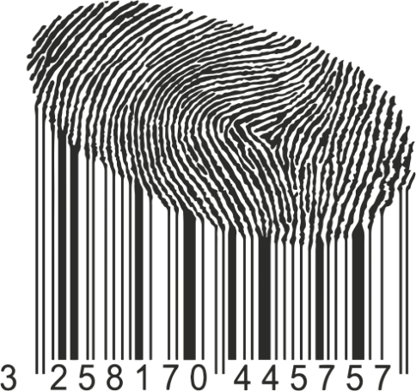

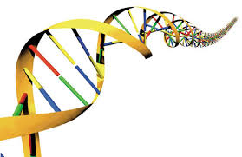








Barcoding species
Select a hypervariable common genomic region
that allows single species distinction
Notes:
DNA barcoding has been first introduced by Hebert from the University of Guelph in Canada in 2003. He proposed a new system of species identification, using short section of DNA from a standardized region of the genome. That DNA section was chosen to be highly variable so that it could be used to distinguish different species. Yet within species sequence variability has to be much lower, in the way that interspecific variability and intraspecific variability would not overlap, creating a gap that is used to for the delimitation of MOTUs, which are used as proxies for species. Such sequences can be used as an identifier for the species
The region used as a barcode differ according to the group of organisms considered, and for metazoans it is generlaly a roughtly 700 bp sequence of the mitochondrial cytochrome oxidase 1 gene, but ITS, protion of 18S, 16 S in bacteria and archaea or plastid genes in plants (rbc : Large subunit of ribulose 1, 5 bisphosphate carboxylase/oxygenase (RUBISCO)) are used.

Slide 5
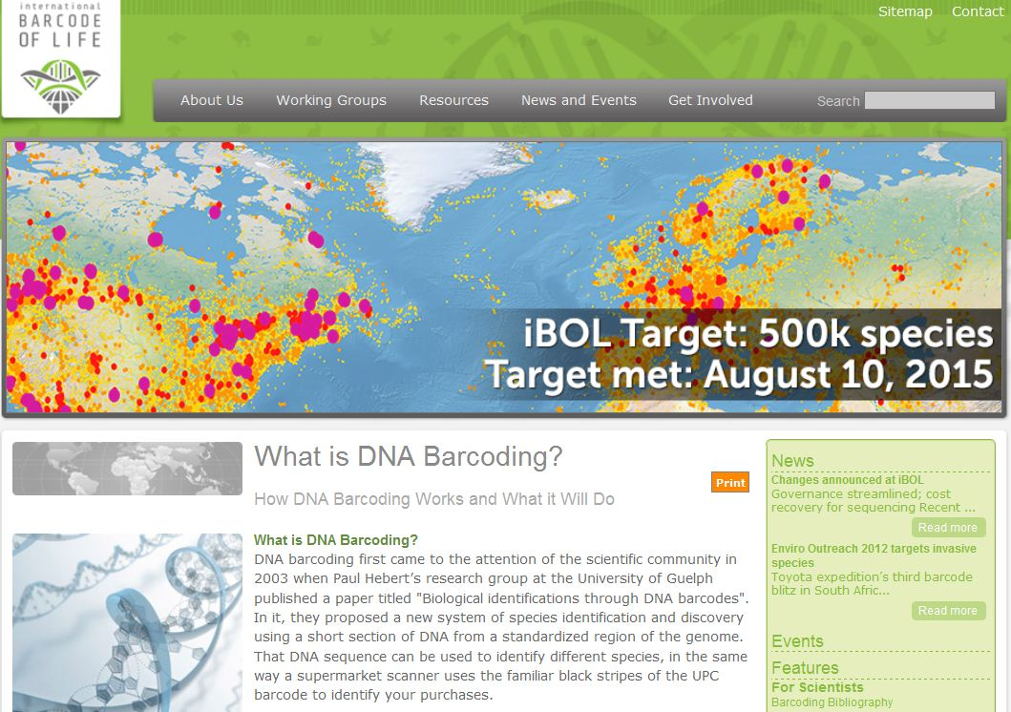
Identifying species with DNA barcoding
www.ibol.org
Notes:
Since the introduction of barcodes by Hebert, the barcode of life project has allowed to coordinate international efforts to produce barcodes, providing a reference library of DNA barcodes associated whit taxonomic information that can be used to assign identities to unknown specimens.
Barcodes are also present in other repositories such as NCBI, but taxonomic information in these databases are not always correct.

Slide 6
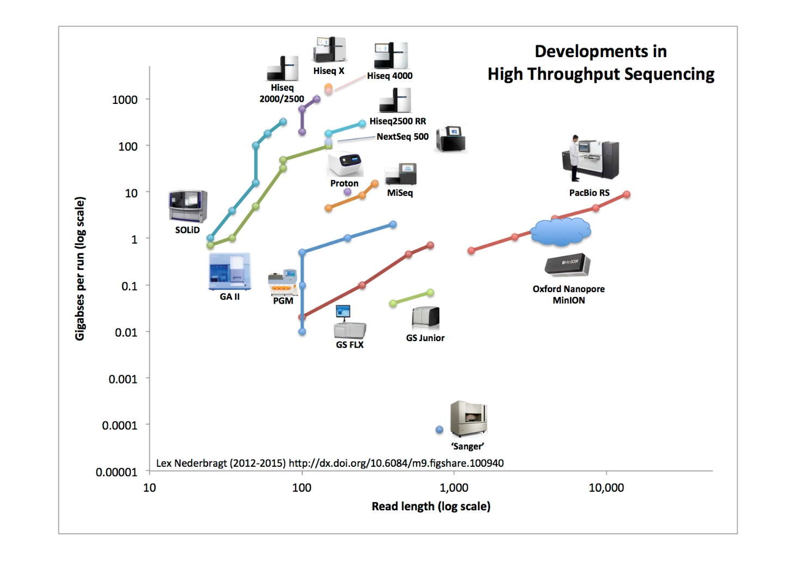
Next Generation Sequencing
MiSeq: 25 millions of reads with 2x300 bp : 15 Gb/run
Sanger: 96 reads with ~ 1000 bp : 0,0001 Gb/run
Notes:
With next generation sequencing methods, sequencing capacities have increased by several orders of magnitude, at a constantly decreasing cost per sequenced base pair. This graph is showing the different sequencing methods and platforms that are quickly developping. I am not going to go into the details of the different methods, but this shows the amount of base pair sequenced in a run for each type of sequencing platform. As you can see, there is a relative loss in the length that can be sequenced with the NGS compared to what is achieved by sanger sequencing, but technlogies are evolving fast, and soon we should be able to get much longer sequences : the Minion thechnology developped by Nanopore already is able to sequence several thousands bp in a single read.
Just to highlight the difference in the amount of data that are produced by sanger, and by miseq (which is one of the platform that is currently able to give the longest reads, if we do not consider pyrosequencing which is going to be stopped soon)

Slide 7
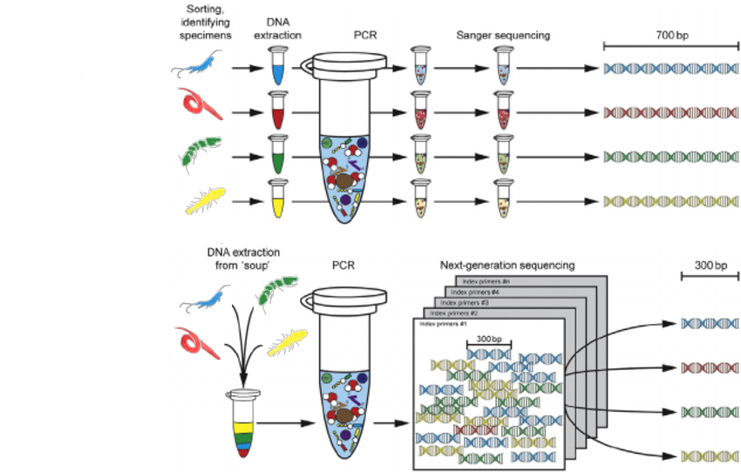
DNA barcoding vs Metabarcoding
DNA Barcoding
Metabarcoding
Modified from Gill et al, 2016
Notes:
How does metabarcoding works ?
I am taking here

Slide 8
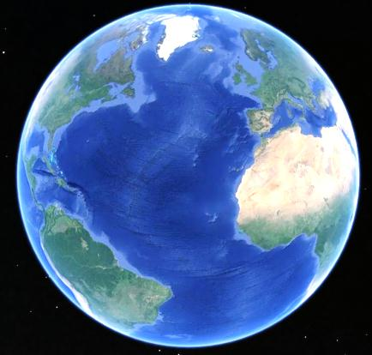
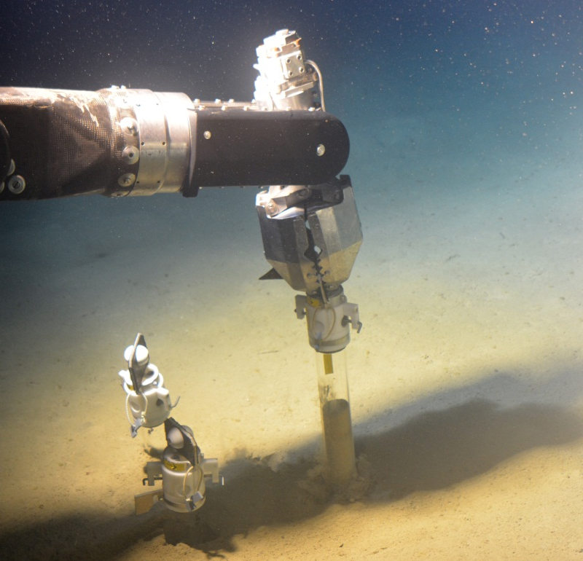
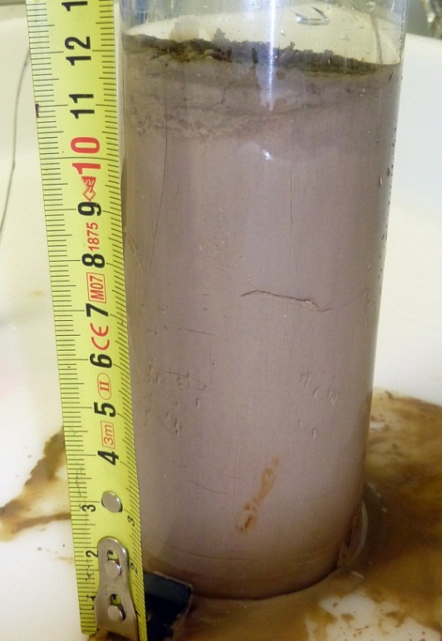



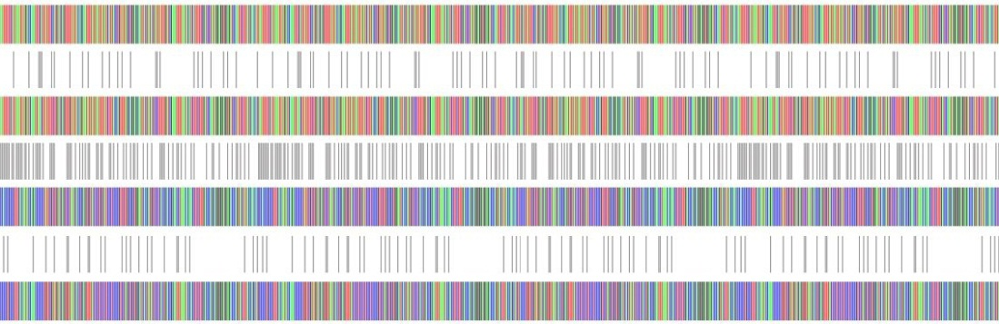
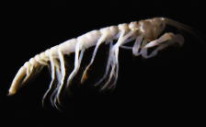
Metabarcoding analyses
Community analyses starting from DNA/RNA environmental samples

Slide 9
Environmental DNA (eDNA)
• Environmental DNA refers to DNA that can be extracted from air, water, or soil, without isolating any specific type of organism beforehand
• Two types:
- intracellular eDNA
- extracellular eDNA

Slide 10
Constraints of working with eDNA
• Complex mixture containing degraded DNA
• The eDNA extract must be representative of the local biodiversity
• The primers must be highly versatile (to equally amplify the different target DNAs)
• Problem of the taxonomic resolution when using very short barcodes
• Problem of the reference database when using non-standard barcodes

Slide 11
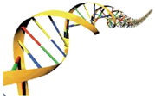
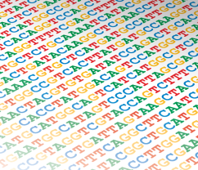

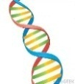

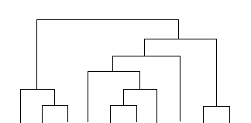

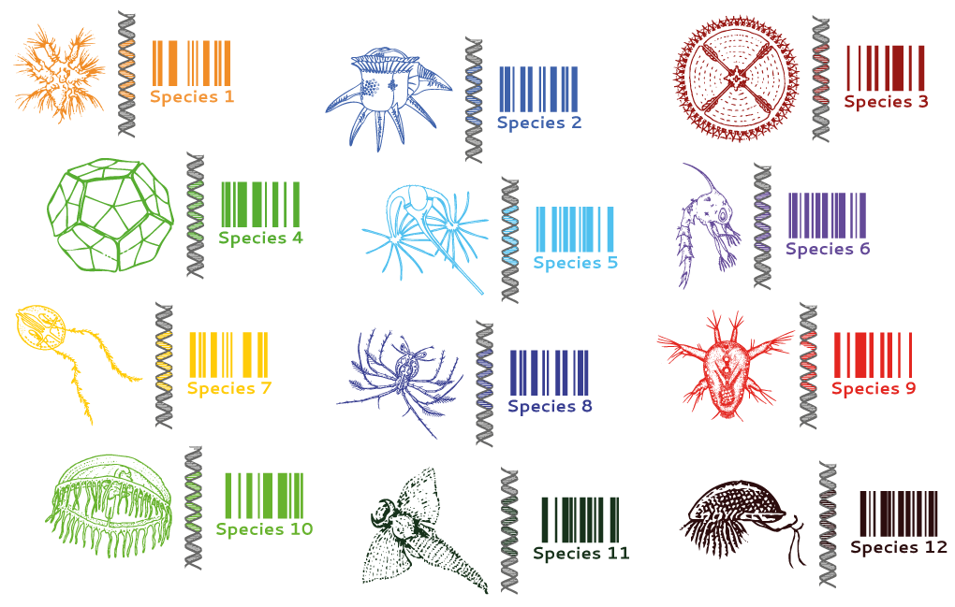
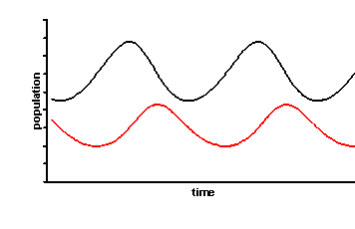
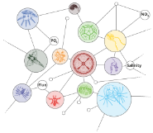
Metabarcoding workflow
Amplification
of barcode region
DNA extraction
Sequencing
Genetic analysis
Sampling
Size-class
fractionation
Sequence
Filtering
Bioinformatic
analysis
Clustering
(OTUs)
Environmental
sampling
Ecological analysis
Taxonomic
assignation
Population
dynamics
Diversity
Community
structure
From R. Siano & S. Arnaud-Haond

Slide 12
Metabarcoding workflow
Temporal and spatial variability representation
Replicates
Volume of sample (biodiversity saturation)
DNA or RNA (both?)
Size fractioning
Sample preservation
Sampling
Size-class
fractionation
Environmental
sampling
From R. Siano & S. Arnaud-Haond

Slide 13
Metabarcoding workflow
Amplification
of barcode region
DNA extraction
Sequencing
Genetic analysis
DNA Extraction kit
Taq Polymerase choice
Choice of barcode region to amplify
Equimolar library preparation (to make sample comparable)
Sequencing technology (Illumina Miseq 2x250 bp)
Platform for sequencing
From R. Siano & S. Arnaud-Haond

Slide 14
Metabarcoding workflow
Data file management and reading
Errors of sequencing (chimera detection)
Sequence clustering method (OTUs definition)
Taxonomic reference database
% identity to reference sequence
Different taxonomic level of assignation
Sequence
Filtering
Bioinformatic
analysis
Clustering
(OTUs)
Taxonomic
assignation
From R. Siano & S. Arnaud-Haond

Slide 15
Metabarcoding workflow
Richness v/s abundance OR presence/absence
Variable number of barcode copies per organism
α and ß diversity
Community structure (% of each OTU)
Unknown diversity
Single OTU dynamic
Ecological analysis
Population
dynamics
Diversity
Community
structure
From R. Siano & S. Arnaud-Haond

Slide 16
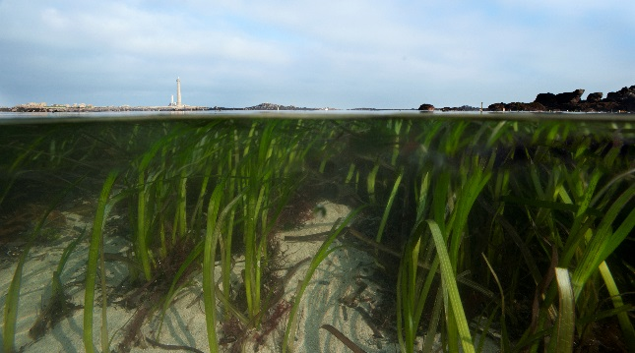
Comparison between morphological and molecular biodiversity surveys
© Ifremer, O. Dugornay
Cowart et al., 2015, PloSONE
Notes:
Survey of Zostera marina seagrass meadows accross brittany, comparing morphological data collected oer a 10 years survey of the coast

Slide 17
Survey of Zostera marina seagrass meadows
Sampling: standardization and representativity:
6 locations occross Brittany
2 quadrats per locations
3 cores per quadrate
Quadrates: 20x30 m
Cores: 10 cm ø 15cm depth
© Ifremer, O. Dugornay
660.000 sequences
(410.000 COI & 150.000 18S)
150 000. meadow⁻¹
75 000. quadrate⁻¹
24 000. core⁻¹
8000.fraction.core⁻¹
Sieving (avoid dominance)
DNA processing: std extraction 10g
Two pairs of universal primers
Massive sequencing
Cowart et al., 2015, PloSONE

Slide 18
α-diversities:
18S: 1174 MOTUs (+ 48 unassigned)
COI: 944 MOTUs (+12.000 unassigned)
Morphology: 322 species
➔Efficient!
For the 44 more common species present in the reference libraries a total of 30% (COI) and 60% (18S) retrieved at least to the family level:
38% to the species level
50% to the genera
65% to the family
➔ Yet blind?
Distinct numbers & ranking for morphological & molecular surveys
Cowart et al., 2015, PloSONE

Slide 19


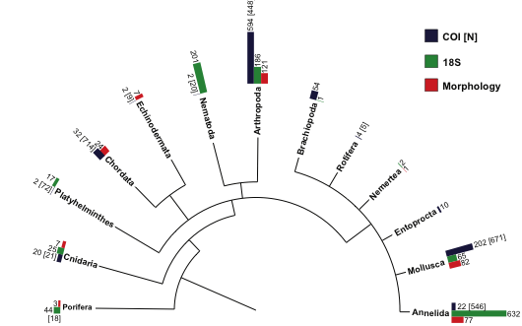


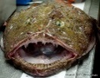
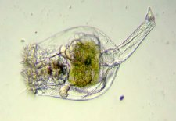
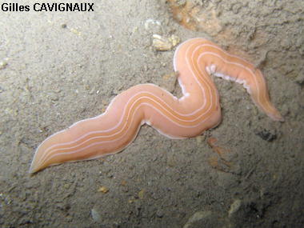
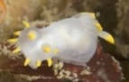
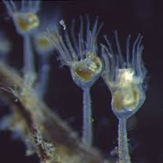
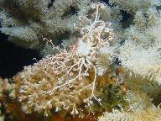

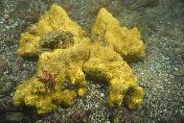
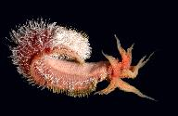
α-diversities: selective blindness or efficiency of each method
Affinity to distinct taxonomic groups: complementarity
Morphology
  Annelids,
  Molluscs
  Arthropods
  Chordates
COI:
  Molluscs
  Arthropod
  Chordates
  Cnidarians
  Brachiopods
18S:
  Annelids
  Nematods
  Molluscs
  Arthropods
  Cnidarians
  Porifera
Cowart et al., 2015, PloSONE

Slide 20
β-diversities
Despite presence/absence versus quantitative data, similar pattern of differentiation among meadows with morphological or molecular data
Even a recently recolonized one shows the same signature
➔Efficient & reliable on the basis of partial community characterization
Morphology
COI
Cowart et al., 2015, PloSONE

Slide 21
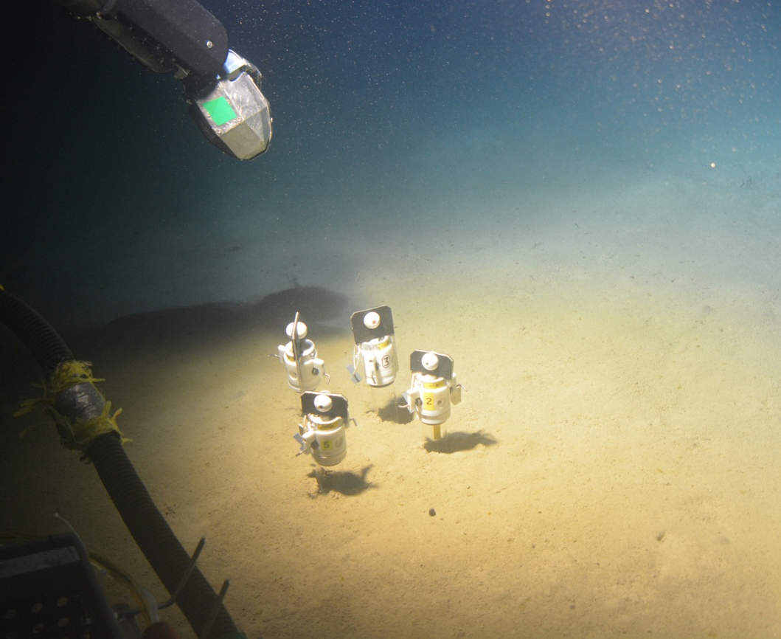

Pourquoi pas les Abysses ?
ABYSS

Slide 22
The race for biodiversity assessment
250.000 species described according to the Census of Marine Life (upon 1.8 millions total described), we await 2 to 10 millions: with such rhythm (2 species.week⁻¹): 10.000 years at least.
We explored less than 5% of the deep sea.
A deep sea core can take 3 to 6 human weeks to deliver biodiversity assessment (not at the species level).
Emergence of mineral exploitation: what knowledge, or lack of, will biodiversity assessment and impact studies be based on?

Slide 23
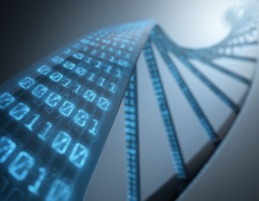
ABYSS objectives
NGS « New » Generation Sequencing and environmental DNA : new tools to reveal the invisible?
Goals of the project: take advantage of the new kind of biodiversity Inventories to contribute to a reevaluation of the biodiversity in the bottom of the oceans
Seuencing speed
Price (dollars.kilobase)

Slide 24
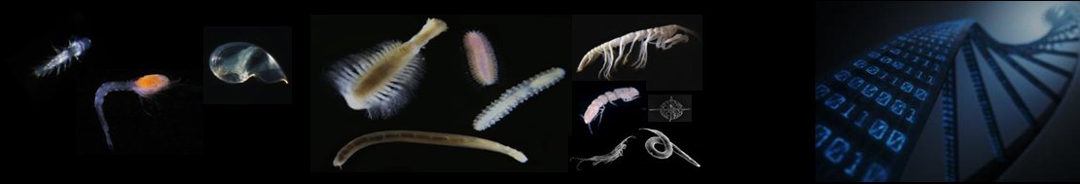
ABYSS objectives
• Improve molecular and bioinformatic tools to provide inventories of procaryote and eucaryote diversity;
• Explore the extent and distribution of marine life, particularly in the deep-sea;
• Reveal biotic and abiotic interactions influencing the dynamic and the evolution of marine biodiversity;
• Evaluate the temporal fluctuations of those distributions;
• Move toward standardized protocols for future Environmental Impact Assessments;
• Contribute to a better understanding of the evolution of the main living phyla.

Slide 25
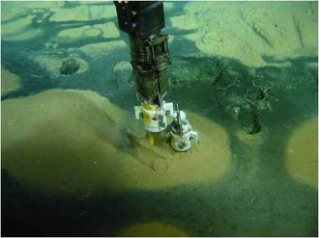
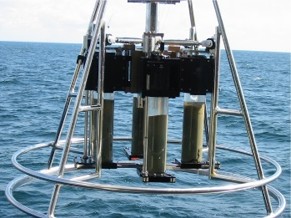
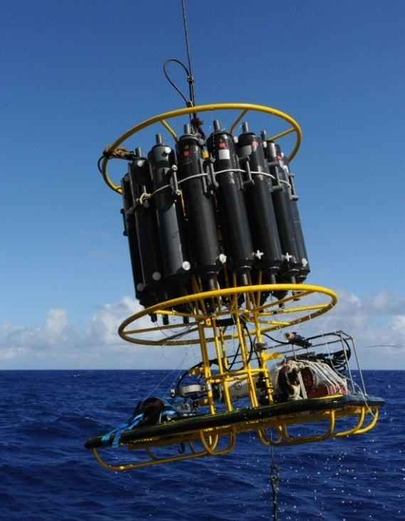
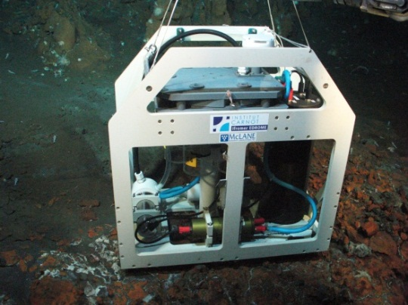
Sampling strategy : a mix of planned cruises and opportunistic sampling
Strategy: gathering sediment and water samples from the broadest possible geographic range to assess deep sea marine biodiversity (prokaryotes and eukaryotes) and its distribution patterns, in relation with possible environmental or biogeographical drivers

Slide 26
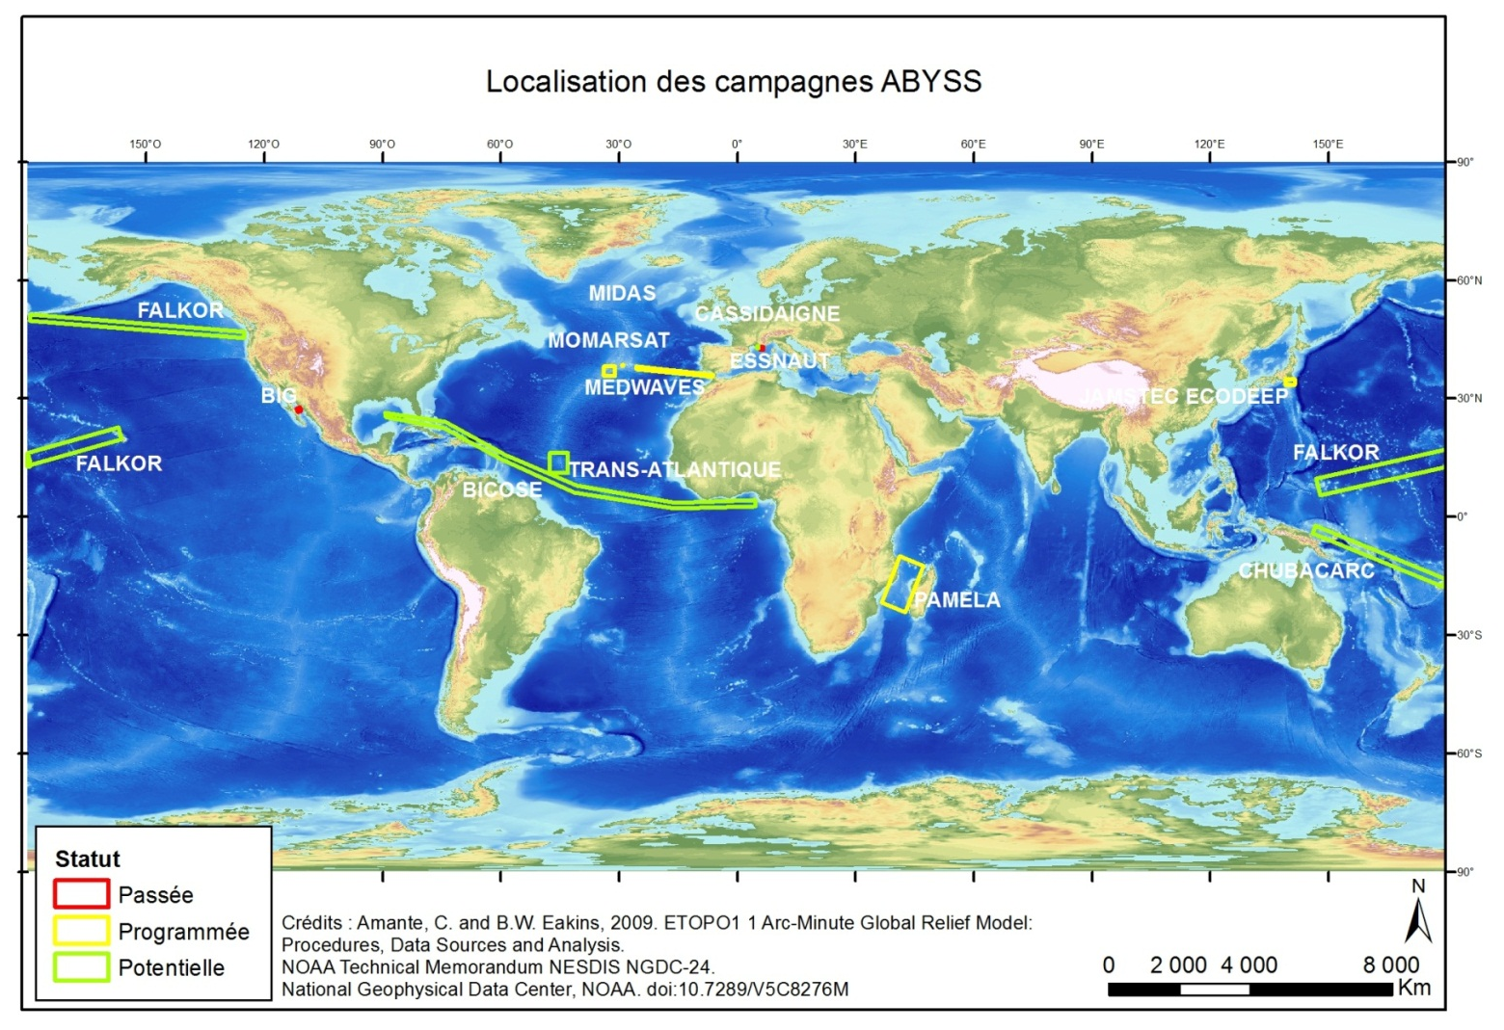
Sampling strategy : a mix of planned cruises and opportunistic sampling

Slide 27
A standardized sampling protocol
• Collection of 3 sediment cores from each sites
• Processing of samples onboard : 2 scenarios envisioned
Time-saving scenario
Ideal scenario
0-1 cm
1-3 cm
3-5 cm
Step 1: cutting cores in depth layers
5-10 cm
10-15 cm
1 mm
Step 2 : sieving each depth layer
500 µm
250 µm
40 µm
20 µm
Step 3 : preserving in individual ziploc bags at -80°C
Freezer -80°C

Slide 28
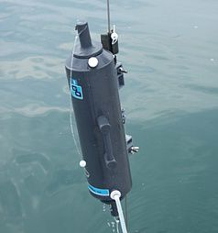
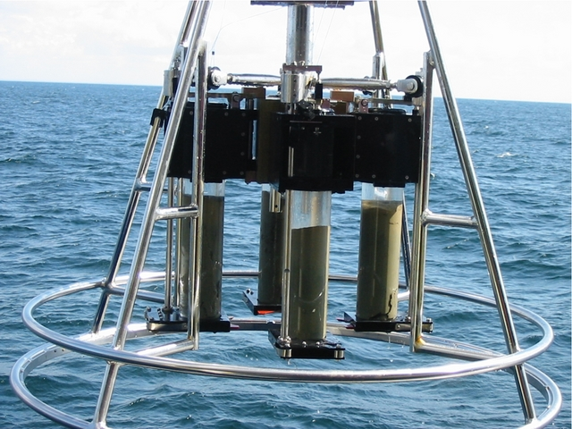
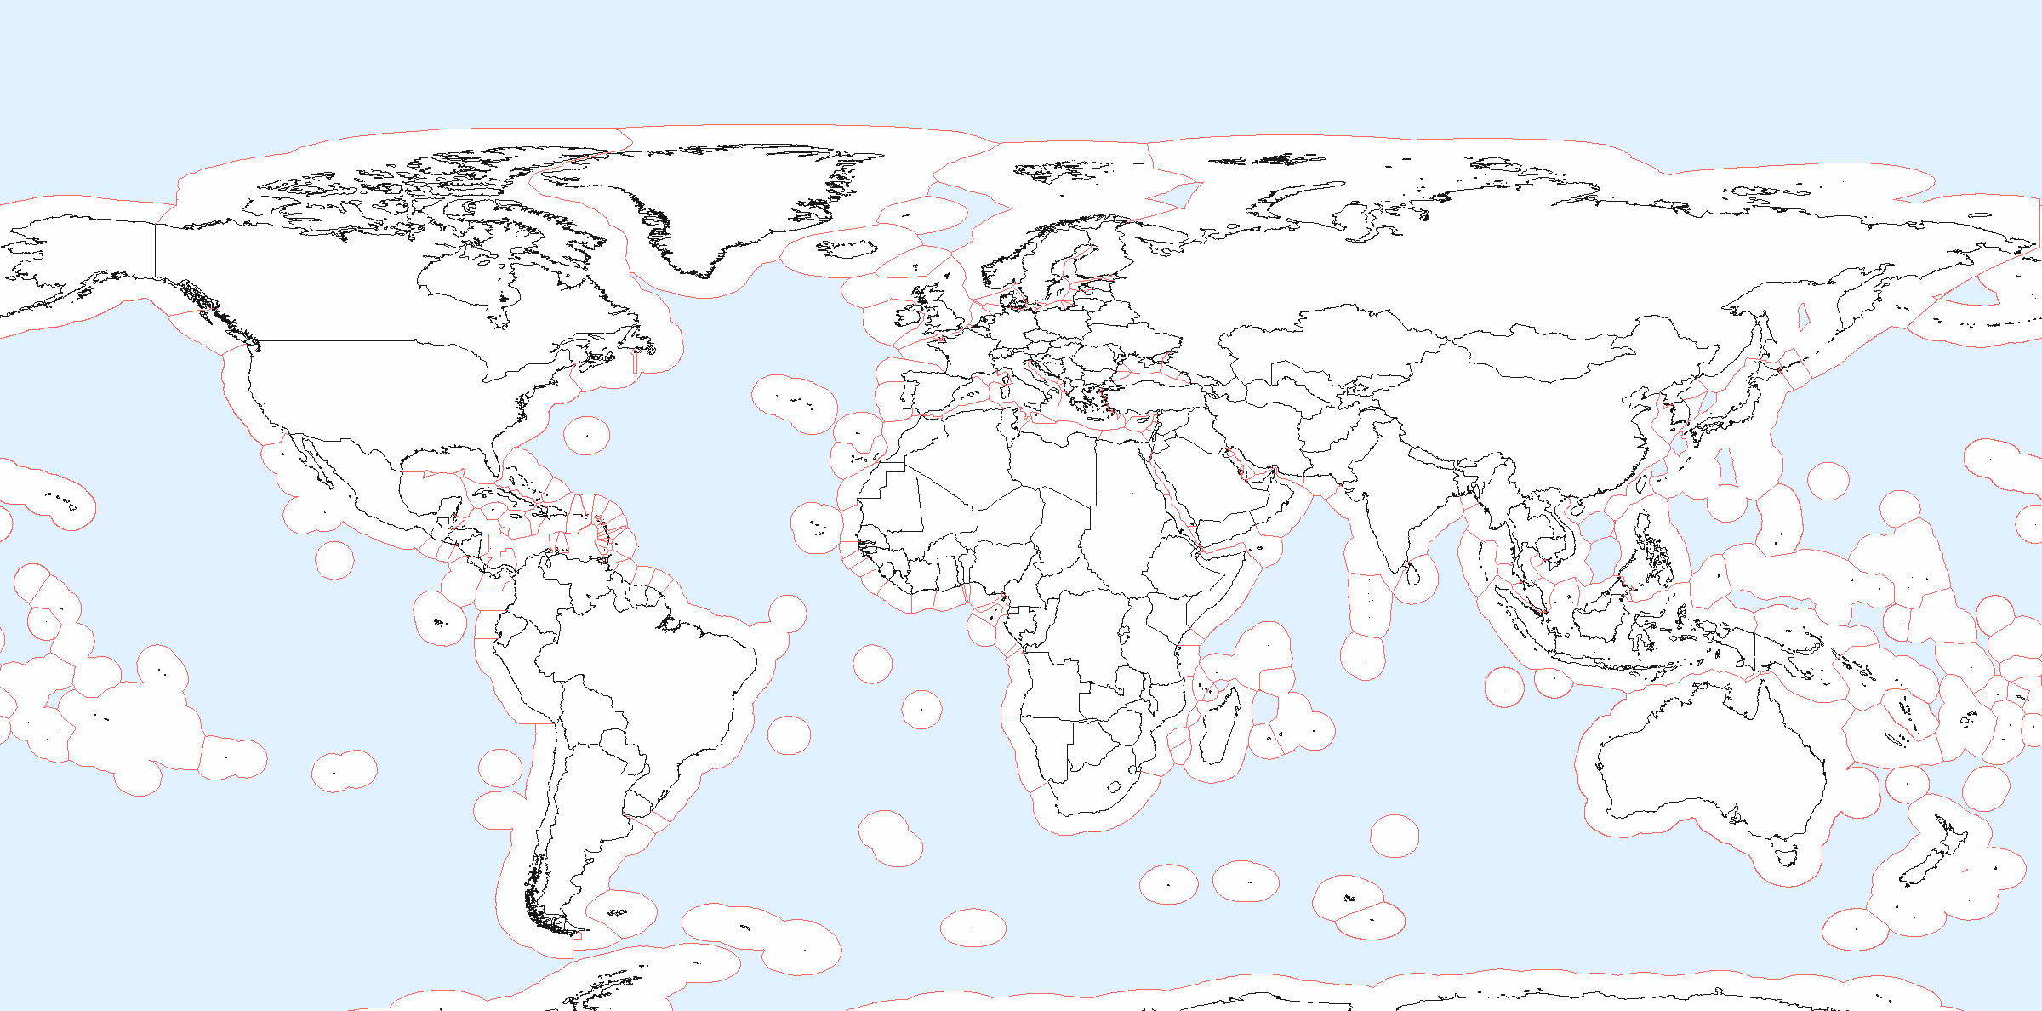
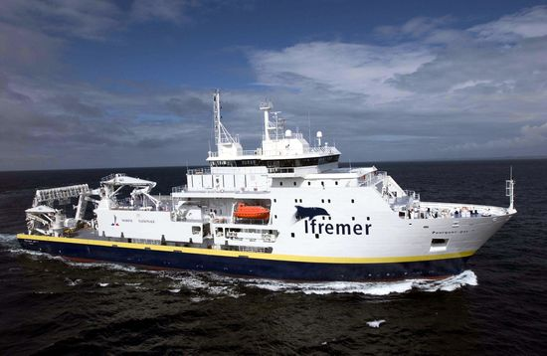
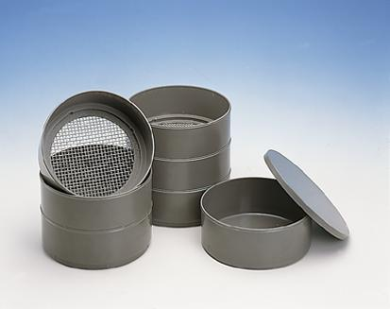
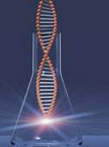
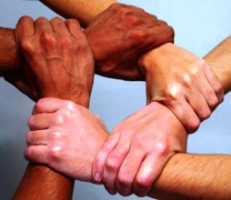
eDNA: a standardized sampling strategy
Sample collection 2016-2018
With a little help…

Slide 29
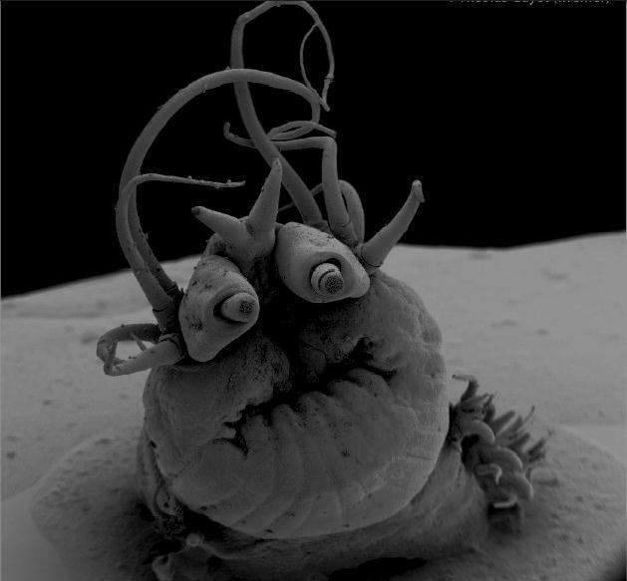

Thank you !
Many tanks
To the organizers and sponsors of Meioscool 2016
To the participants and collaborators of the ABYSS project
And to you for your attention !

Slide 32
eDNA
New Generation Sequencing (NGS) allows the production of thousands sequences for a given template DNA
Metabarcode takes advantage NGS to characterize the target gene (rDNA 16S for bacteria, COI or 18S for most eucaryote animals) on environmental DNA (water, sediment…)
➔thousands sequences automatically assembled by sample (each DNA is tagged) and the clusters of similar sequences (<4% divergence as expected for species) are called MOTUs.
MOTUs then blast to reference libraries to be assigned to the closest taxonomic group

Slide 33
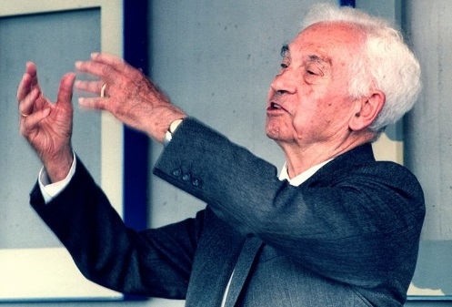
Biodiversity assessment rely on the Species concept
Biological species concept, according to Ernst Mayr (1940):
“groups of actually or potentially interbreeding natural populations, which are reproductively isolated from other such groups”
➔Hardly amenable to experimental tests for most cases, let alone the deep sea➔Looking for the best proxy?

Slide 34
Proxy for species delineation in biodiversity assessment?
  Morphology -> Phenetic species concept: A species is a set of organisms that look similar to each other and distinct from other sets (Ridley, 1993).
  But phenotypic plasticity, synonymous species, cryptic species… (and a long time to determine specimens…)
  Genetic divergence -> Evolutionary species concept: A species is a lineage (an ancestral-descendant sequence of populations) evolving separately from others and with its own unitary evolutionary roles and tendencies (Simpson, 1961).

